Slide 1


Technology for Integration and Continuity
Orientation for Primary Care Clinics Using QHR Accuro EMR
Version: June 2021

Slide 2
Sections
Section | Slides
Where did CII/CPAR come from? | 3
Why CII/CPAR? | 4-8
What are CII/CPAR? | 9-13
How do they work? | 14-21
Data Mapping - Encounters | 22-33
EMR Confidentiality | 34
Sending Consult Reports | 35-42
Sending Panels to CPAR | 43-50
Future State | 51
eNotifications | 52-55
Benefits of CII/CPAR | 56
Readiness Criteria | 57-65
What must physicians do? What is optional? | 66-68
Next steps once you’re ready | 69-73
Pre Go-Live tips | 74-78

Slide 3




CII and CPAR were at the Request of Physicians
The Central Patient Attachment Registry was at the request of Family Medicine (SGP at the time).
A commitment was made to build this tool for primary care.
Alberta’s community specialists requested technology to submit consult reports to Netcare (CII) at AMA Rep Forum.
Partners:
Notes:
Key Messages:
October of 2016 the Amending Agreement was ratified between Alberta Health and the AMA.
CII/CPAR is something physicians have been asking for.
Commitment from both parties to develop the Central Patient Attachment Registry as a tool for primary care and a key technical enabler for continuity of care.
In the summer of 2018 the AMA, AHS and AH agreed to merge the two projects of Community Information Integration and CPAR with enhanced value components for continuity.
The ability to upload consult reports to Netcare, CII, was a resolution from specialists at AMA representative forum.
Key point – this has been at the request of physicians.

Slide 4
Why Technology for Integration
& Continuity?

Slide 5
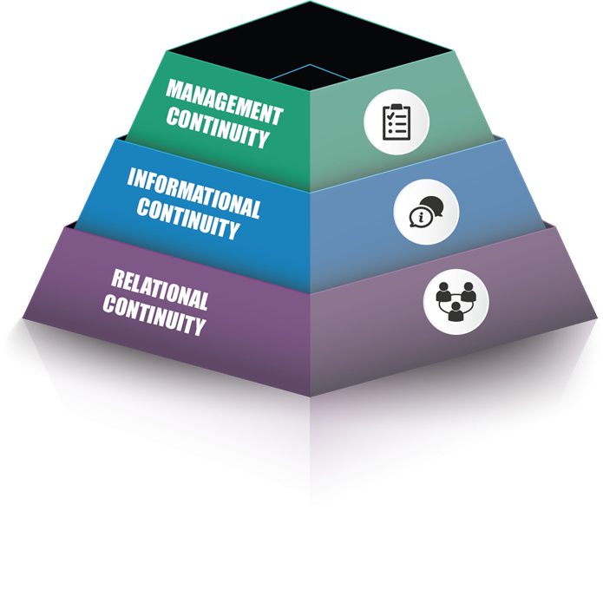
Continuity Defined
Relational continuity is defined as:
The ongoing, trusting therapeutic relationship between a patient and a primary care physician and their team, where the patient sees this primary care physician the majority of the time
Continuity of Care: a multidisciplinary review,
JL Haggerty et al, 2013
Notes:
Expanded Definition of Continuity (that encompasses all 3 types of continuity):
Continuity in primary care is mainly viewed as the relationship between a single primary care provider and a patient that extends beyond specific episodes of illness or disease. It implies quality care over time (as experienced by the individual patient) and the linking of information and providers across different events. For continuity to exist, care must be experienced as connected and coherent.
Relational continuity is defined as:
The ongoing, trusting therapeutic relationship between a patient and a primary care physician and their team, where the patient sees this primary care physician the majority of the time

Slide 6
Rationale/Benefits
Evidence shows that when a patient has a continuous relationship with a primary provider and care team, the overall result is better than when care is disjointed or broken
Higher continuity is associated with improved health, quality of life, and reduced mortality
Notes:
CII CPAR is about improving continuity of care. This is NOT about telling patients they can only receive care from one physician. Patients have the right and need to receive care as required including having a regular family doctor and going to walk-in clinics as needed.
Research reveals that a consistent relationship between patients and their family doctor and team can make a big impact on health. Seeing the same family doctor can lead to higher quality of care than seeing a different doctor and team each time. Studies show that people who know and trust their healthcare providers have lowered risk of chronic disease and early death.

Slide 7
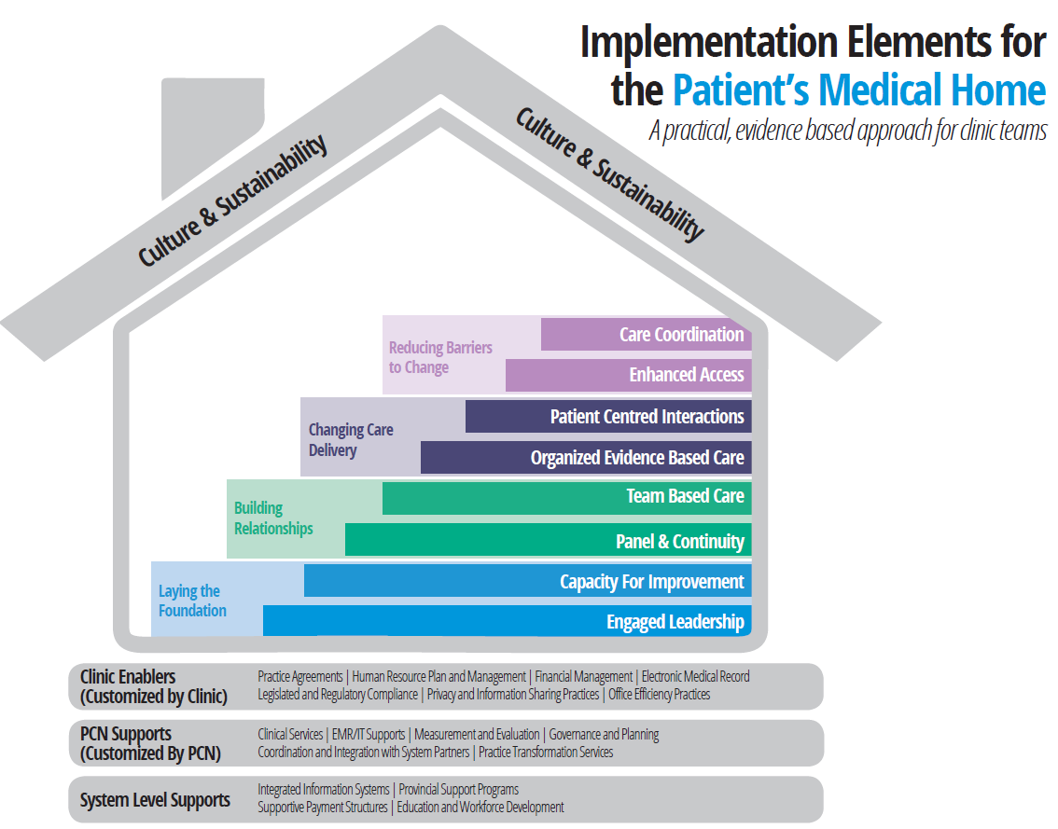


CII/CPAR Alignment with PCN Initiatives
Patient’s
Medical
Home
Transitions of Care
Continuity
Of
Care
Opioid Response
Notes:
CII/CPAR is in direct alignment with PCN initiatives:
Continuity is a critical goal of Patient’s Medical Home (PMH), and one of the eight evidence-based implementation elements that guide the PMH journey in Alberta.
CII/CPAR will support transitions of care with the identification of the primary provider in Netcare. E-notifications will enable smoother transition of care and can even assist in the opioid response
(Example re opioid; when enabled, primary providers will receive an e-notification after day surgery. Currently many providers are unaware when surgery such as knee replacement occurs and are not notified to provide early follow-up with a patient at risk of addiction).

Slide 8
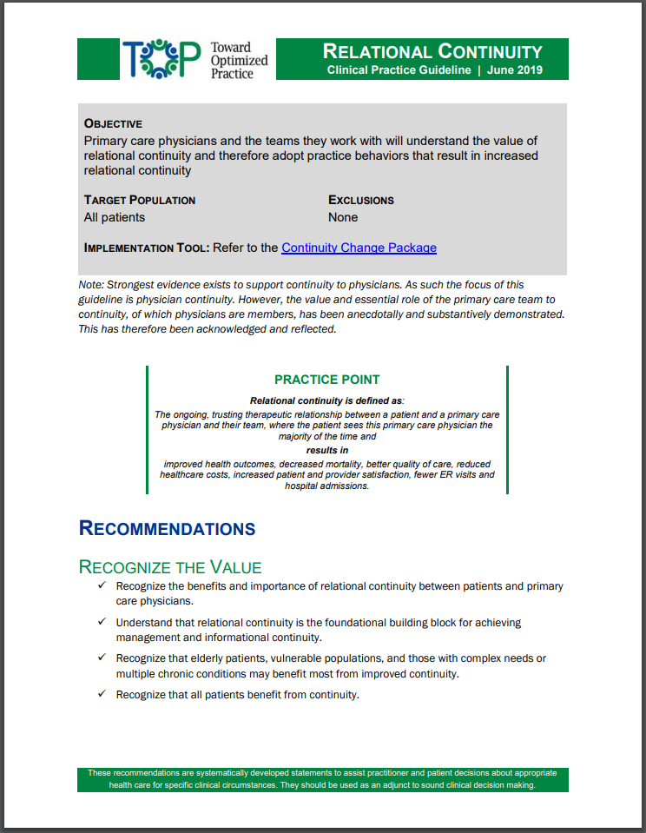
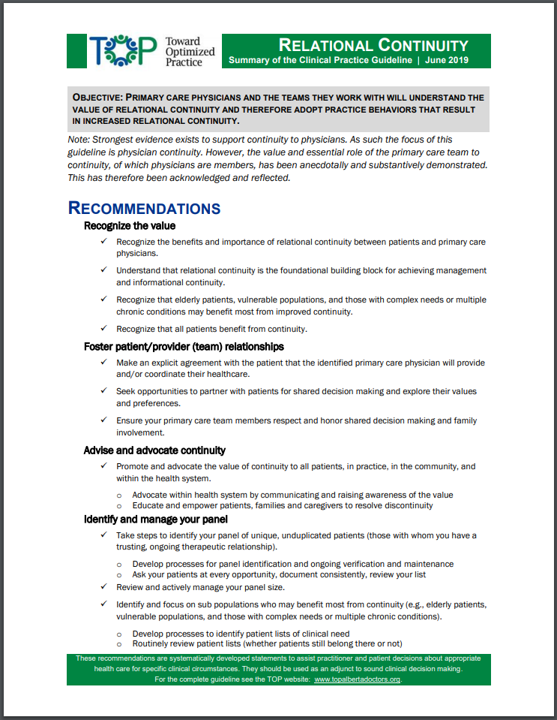
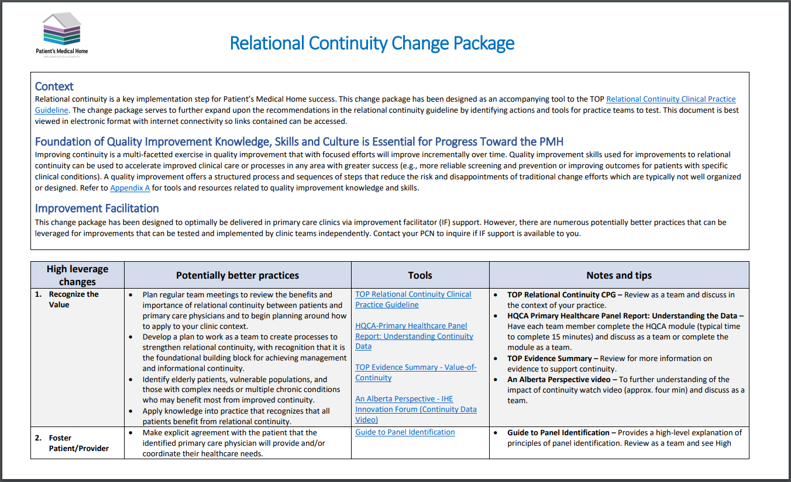
New TOP Relational Continuity CPG
June 2019
Change Package
Guideline
Summary
Notes:
Angille
OBJECTIVE: PRIMARY CARE PHYSICIANS AND THE TEAMS THEY WORK WITH WILL UNDERSTAND THE VALUE OF RELATIONAL CONTINUITY AND THEREFORE ADOPT PRACTICE BEHAVIORS THAT RESULT IN INCREASED RELATIONAL CONTINUITY.
Note: Strongest evidence exists to support continuity to physicians. As such the focus of this guideline is physician continuity. However, the value and essential role of the primary care team to continuity, of which physicians are members, has been anecdotally and substantively demonstrated. This has therefore been acknowledged and reflected.
CPAR is an enabler for relational continuity

Slide 9
What are CII and CPAR?

Slide 10
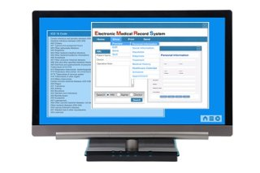
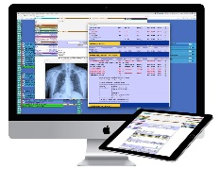


What is Community Information Integration (CII)?
CII is a system that collects select patient information from community Electronic Medical Records (EMRs) and shares it with other members of the patient’s care team through Alberta Netcare.
Alberta Netcare Portal
Community
Physician Office
EMRs
CII Data
Hub
Healthcare Data
Repository
Notes:
Key Messages:
CII is designed to allow information to flow from community physician EMRs to other areas of the health care system so that the information can be used to deliver better care.
Initially information will flow to Aberta Netcare to be used by other health professionals; for example, through CII, if a patient has to go to the Emergency Department, the care providers will have access to the information from the patient’s medical home and specialist consult reports.
Information will also flow to the Healthcare Data Repository at Alberta Health to be used for population health quality improvement activities

Slide 11
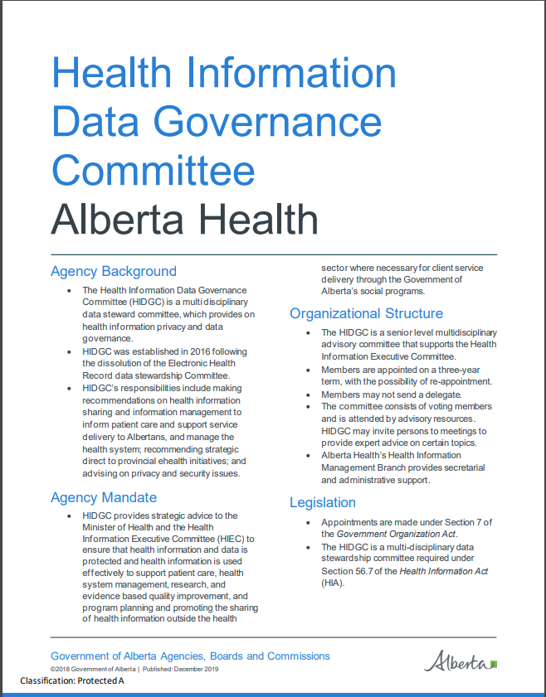
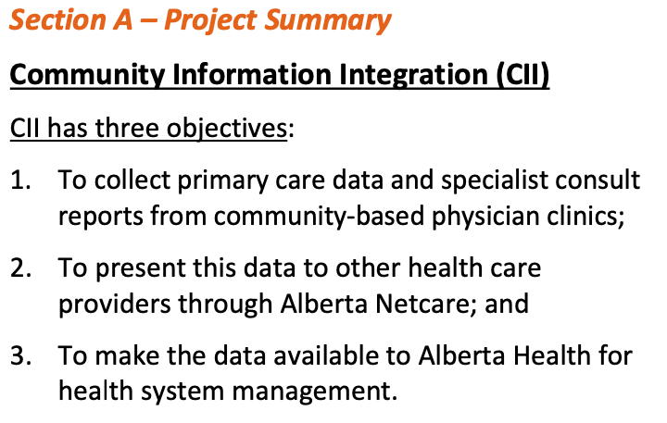
Healthcare Data Repository
Database for health system analytics in Alberta
Access limited and requires approval
For planning, quality improvement and health system management
Use of the information is governed by the Health Information Data Governance Committee (HIDGC)
CII PIA Summary and Expedited PIA Instructions
Page 2: CII Project Objective 3:
https://actt.albertadoctors.org/file/HIDGC_Overview_Fact_Sheet.pdf
Notes:
Key Messages:
The Healthcare Data Repository is a database created by Alberta Health to gather information from across the healthcare system including community EMRs
So new that it contains limited information that isn’t currently being used at all
The only people who currently have access are technicians responsible for making sure everything is operating properly
Alberta health will ”use this information within its data analytics systems to perform such activities as planning, quality improvement and health system management.” (PIA summary page 4)
All high performing health care systems have this capability, Alberta is aligned with this
Use of this information for system improvement will benefit everyone – efficiency, cost savings, better resource allocation, better outcomes (???)
This system is not intended or designed to be used for performance management
The data collected for the HDR is similar to data collected for billing, but not the same; and of course collected for a different purpose. Billing data is not available for the kind of analytics needed for sophisticated health system management
There is GOVERNANCE!
The Health Information Data Governance Committee is responsible for making recommendations on how the data may be used

Slide 12
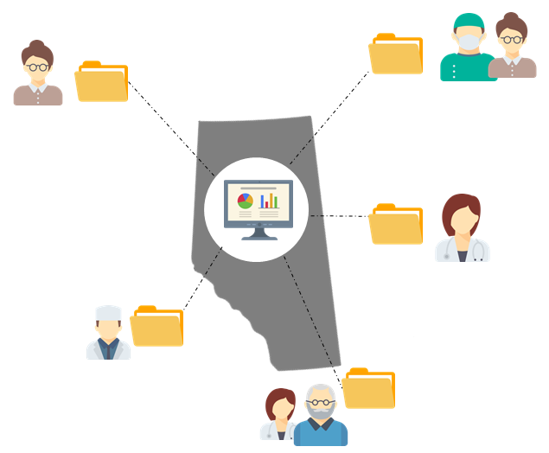
Central Patient Attachment Registry (CPAR)
A provincial system that captures the confirmed relationship of a primary provider and their paneled patients.
Receives information automatically from clinic EMRs on a monthly basis
Next logical step for practices that have invested in panel management
Foundational for enhancements of informational continuity such as eNotifications
Notes:
Key Messages:
CPAR supports new processes so that family doctors and teams can confirm their relationships with patients and share it through Alberta Netcare. This will help reinforce the consistent relationships between patients and their providers.
Panels will be uploaded monthly, automatically, from clinic EMRs. This monthly capture is needed because panels are fluid. They change as patients are born, pass, join the practice and leave the practice.
Panel information in the registry is crucial to future enhancements in Alberta. It is the source of truth of panel.

Slide 13
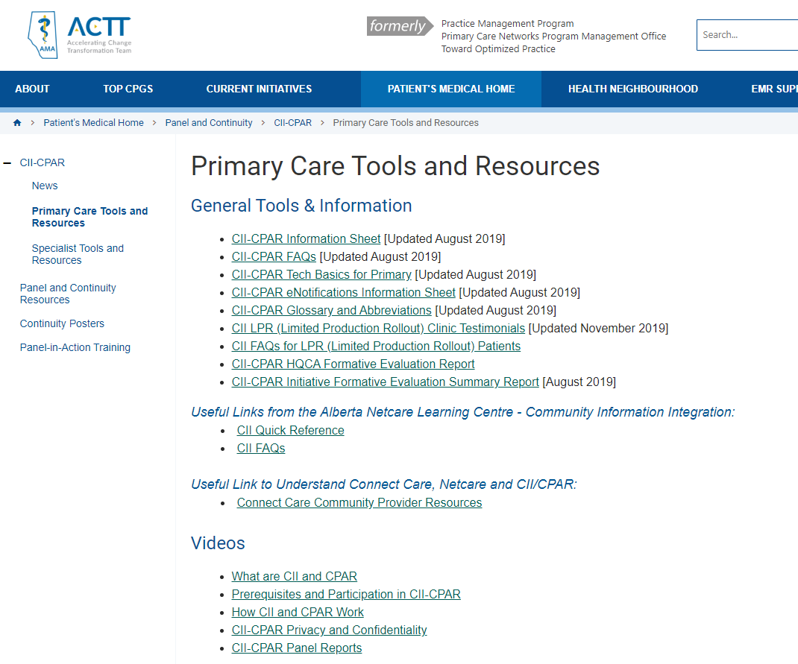
Tools and Resources Web Page
https://actt.albertadoctors.org/cii-cpar/toolsresources
Key Resources found here:
Privacy Tools
  PIA Update Self-Assessment
Clinic Journey Checklist
Panel Readiness Checklist
Team Toolkit
EMR Guides
Participation Forms
Always go to the web page for the most
updated resources
Notes:
All tools referred to in this slide deck may be found on the CII/CPAR Tools and Resources page. https://actt.albertadoctors.org/cii-cpar/toolsresources

Slide 14
How Does CII/CPAR Work?

Slide 15
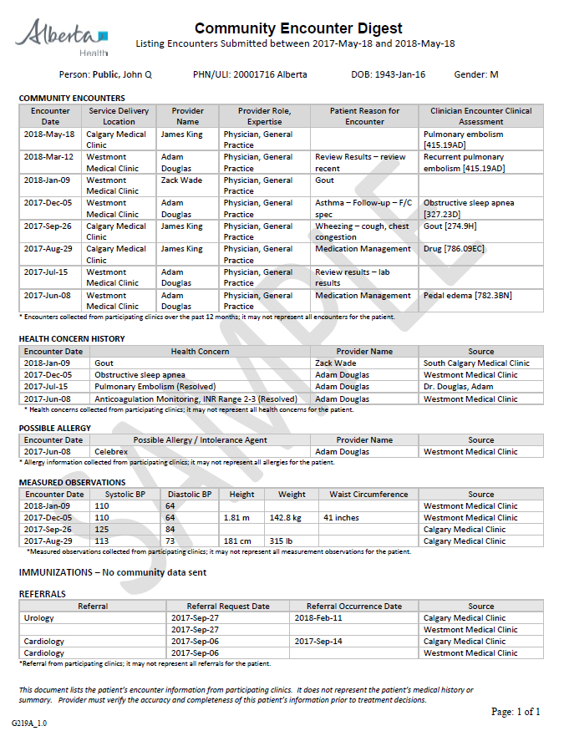

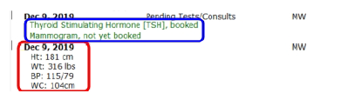
Encounter Data to Community Encounter Digest
CED Report
EMR Encounter Data from defined fields - Automated
Alberta
Netcare
Portal
Community
Physician Office EMR
CII Data
Hub
Health Information
Data Governance Committee
Healthcare
Data
Repository
Example: BP, HT, Wt, WC
Notes:
Key Messages:
Physicians and nurse practitioners need to first register to participate in CII/CPAR.
The first type of patient data shared is encounter data.
EMR encounter data is mapped (defined fields) and uploaded to the CII Data hub and presented in Netcare as a Community Encounter Digest (CED) report and shared with the Healthcare Data Repository to inform program development

Slide 16
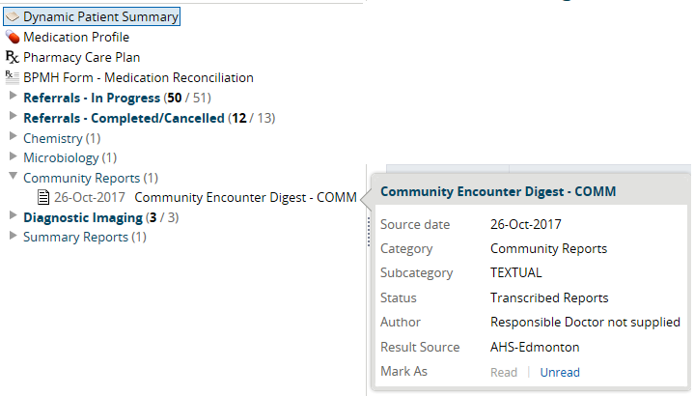
Community Encounter Digest (CED) In Netcare
A new category/folder called “Community Reports” has been added to the Clinical Document Viewer (CDV) tree in Netcare
Notes:
The encounters are rolled up into a 12 month summary called the Community Encounter Digest and these will be displayed in Alberta Netcare in the new “Community Reports” folder.

Slide 17
Community Encounter Digest (CED) Sample
Community Encounters
Encounter Date
Location
Provider Name/Role
Reason for Encounter
Clinical Assessment
Health Concern History
Encounter Date
Health Concern
Provider Name
Source (clinic)
Possible Allergy
Encounter Date
Possible Allergy
Provider Name
Source (clinic)
Measured Observations
Encounter Date
BP, Height, Weight, Waist Circumference
Source (clinic)
Referrals
Type
Request date
Occurrence date
Source (clinic)
Immunizations
Disclosure Message
Notes:
ANIMATED
Key Messages:
For each patient, the Community Encounter Digest (CED) assembles a record of their visits/encounters across all providers participating in CII. It is a rolling snapshot of encounters the patient has had with CII/CPAR enabled clinics over the last 12 months. It is available in Alberta Netcare for other providers in the system to view care the patient has received over the last year and inform care when the patient is in front of them. Only “mapped fields” for which data is entered in a visit flows to the CED in Netcare.
The “Community Encounters” section records the location and reason information for each encounter.
The “Health Concern History” section records any entries made in the problem list during the encounter.
The “Measured Observations” section records any blood pressure, height, weight, and waist circumference values recorded during an encounter.
The “Possible Allergy” section displays any allergy entries made during the encounter.
The “Immunization” section displays immunizations done during the encounter.
The “Referrals” section displays any referrals to specialists done during the encounter.
The disclosure message at the bottom of the CED states:
This document lists the patient’s encounter information from participating clinics. It does not represent the patient’s medical history or summary. Provider must verify the accuracy and completeness of this patient’s information prior to treatment decisions.
See a sample CED here: https://actt.albertadoctors.org/file/CII_CED_Sample.pdf

Slide 18
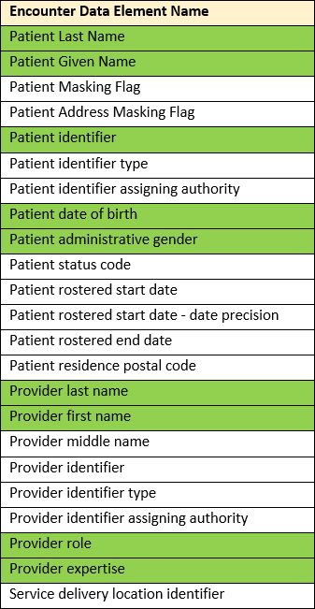
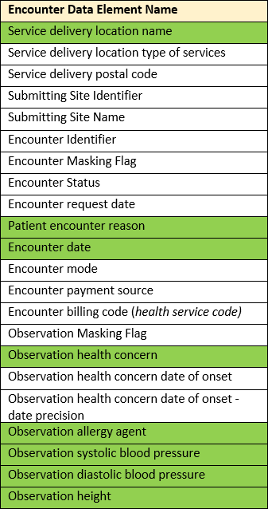
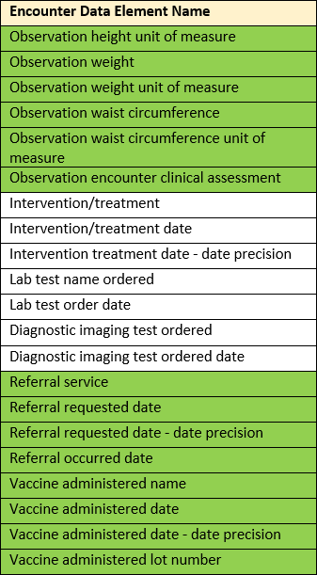
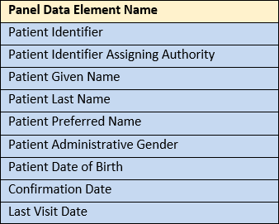
CII Data Elements CPAR
Encounter Data Element Legend:
Netcare – indicates data elements
published in the current CII Community Encounter Digest (CED) report and uploaded to Healthcare Data Repository
Indicates data elements uploaded to Healthcare Data Repository
CPAR – indicates data elements
uploaded to CPAR and Data Repository
Notes:
This shows the exact data elements that are uploaded to Netcare, the Healthcare Data Repository and the Central Patient Attachment Registry. These elements were recommended by CIHI, the Canadian Institute for Health Information, as standard data that should be part of a shared health record.

Slide 19
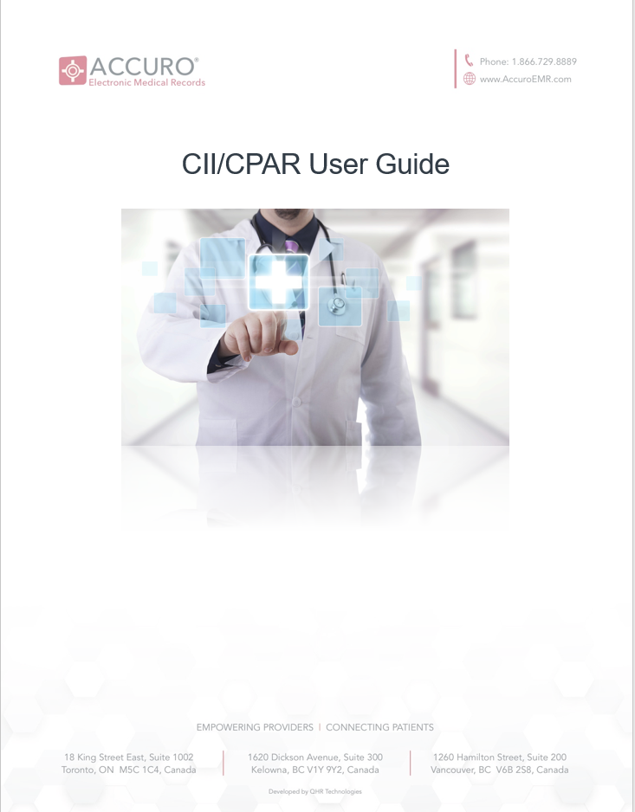
Encounters- EMR Checklist Before Go-Live
Detailed Configuration Instructions Available in User Guide:
https://actt.albertadoctors.org/file/QHR_Accuro_CII-CPAR_Guide.pdf
For Each Provider Submitting Encounters:
Register for CII with eHealth Support Services
Configure Providers for Encounter Data Sharing
Map commonly used Diagnostic Orders, Lab Orders, and Referrals to a new (CII specific) Form Type.
Review EMR mapping
Understand how to prevent encounter data from sending
Notes:
This slide outlines what is required to ensure encounter information can flow to Alberta Netcare. More detailed instructions can be found in the Accuro CII/CPAR EMR user guide on the ACTT website: https://actt.albertadoctors.org/file/QHR_Accuro_CII-CPAR_Guide.pdf
A provider must enroll for CII with eHealth Support Services. For more information about the registration process, see the Get Started page on the ACTT website: https://actt.albertadoctors.org/PMH/panel-continuity/CII-CPAR/cii-for-specialists/Pages/Get-Started-Today.aspx
Configuring Providers for Encounter Data Sharing (these steps must be completed for each provider participating in CII)
Accuro Start Menu → Tools → Configure Providers
Select a Provider and Click Configure
Click the Next button until you get to the Affiliated Programs page
Click the add button and select “CII/CPAR – Encounter Data Sharing” from the list
Click Finish to save your changes
Repeat for every Provider being set-up
The next part of CII configuration includes mapping commonly used Diagnostic Orders, Lab Orders, and Referrals to a new (CII specific) Form Type. Accuro searches the database for the CII Participating Providers, and the Forms these Providers used, that have been categorized with this Type and prepares these documents for CII Submission to Netcare.
For additional information on mapping forms see the “Step 3: Mapping Forms that will be submitted” under the “CII – Encounter Data Sharing” section of the Accuro EMR CII/CPAR guide: https://actt.albertadoctors.org/file/QHR_Accuro_CII-CPAR_Guide.pdf
Review the EMR mapping in the CII and CPAR Accuro Mapping guide: https://actt.albertadoctors.org/file/QHR_Accuro_CII-CPAR__Mapping.pdf
Review the processes for keeping patient data confidential in the Accuro CII/CPAR EMR user guide: https://actt.albertadoctors.org/file/QHR_Accuro_CII-CPAR_Guide.pdf

Slide 20
Conditions that allow for Encounter information to flow to the CED in Netcare
Details Available in User Guide:
https://actt.albertadoctors.org/file/QHR_Accuro_CII-CPAR__Mapping.pdf
Accuro determines if a chart item is valid to submit to CII if the chart item:
  is associated with a valid appointment
  has a recorded owner and the date of service is after the CII go-live date for the provider
  OR
  has no recorded owner but is associated on the schedule with a provider who is live on CII
  is ‘active’
  is added within 48 hours of the appointment
Notes:
Although no steps need to be completed for this data submission to take place, it is important that users understand what types of appointments will be excluded if the following is missed:
The appointment must be considered valid:
The patient is not flagged with Do not share EMR or Consult data with CII
The appointment is not flagged with Do not share EMR or Consult data with CII
The patient has an Alberta ULI
Appointment Date/Time is after the Provider's opt-in date to CII
The appointment is not marked as No Show
The appointment's Facility is not None or Blank.
The appointment is not a Group Appointment
The chart item has a recorded owner OR chart items with no recorded owner (e.g. History of Problems, Allergy, Immunization) must be associated with an Appointment’s Scheduling Provider who has opted into CII
The chart item is “Active” (refer to the “CII Encounter Data Sharing, Clinic Workflow” section of the Accuro EMR CII/CPAR guide for additional details about what makes a chart item “Active”)
The chart item was added within 48 hours of the appointment
There are also some conditions explaining the role of the primary provider (as custodian of the record) and the specialist when they are on the same instance of Accuro. This would occur in a clinic group with one instance of Accuro. An explanation of which information flows is in this document:
https://actt.albertadoctors.org/file/CII-CPAR_Considerations_for_Partially_Onboarded_Clinics.pdf
It becomes important when a specialist wants to participate in CII but the EMR also has family practices using it where the primary provider may not yet be participating in CII/CPAR.

Slide 21
Refer to the Accuro EMR CII/CPAR User Guide
https://actt.albertadoctors.org/file/QHR_Accuro_CII-CPAR_Guide.pdf
Notes:
https://actt.albertadoctors.org/file/QHR_Accuro_CII-CPAR_Guide.pdf

Slide 22
Data Mapping to CED

Slide 23
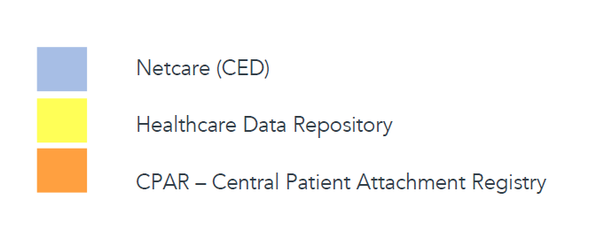
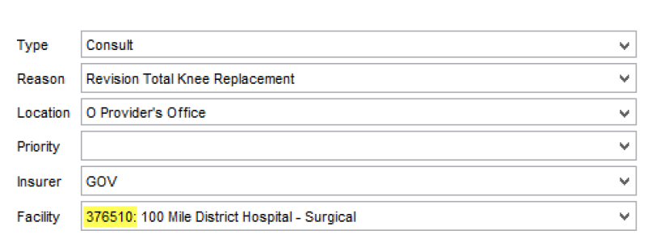
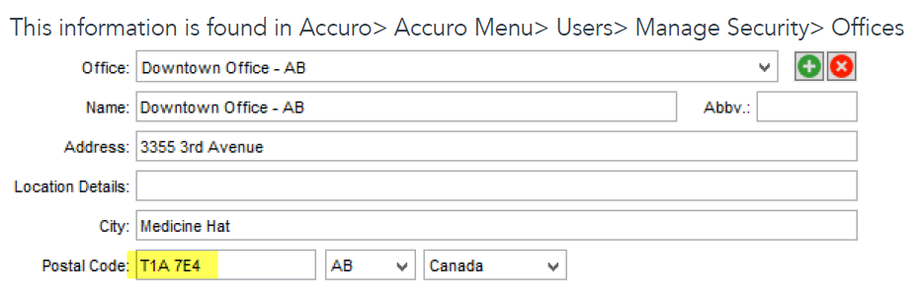
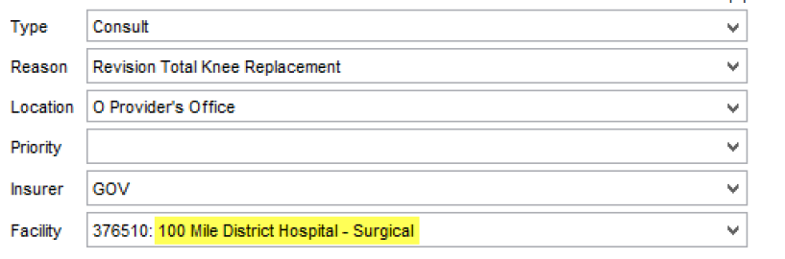
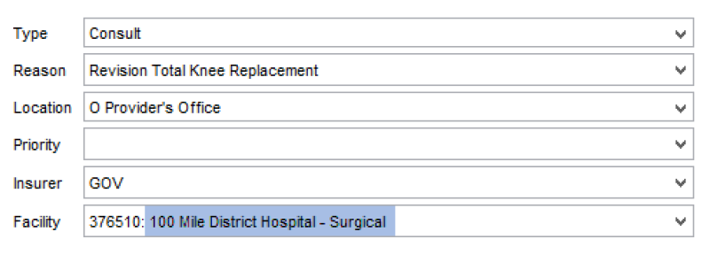
Accuro Data Mapping
Data that Maps to Alberta Netcare CED and the Healthcare Data Repository
Facility Data: Facility Number and Facility Name
Netcare (CED)
Healthcare Data Repository
CPAR – Central Patient Attachment Registry
Office Postal Code
Notes:
CII AND CPAR MATCHING LEGEND
In the CII and CPAR project there are 3 places information will be pulled to within Alberta Health.
1. Netcare – Information is securely shared with other providers can see this information as it is published in the CII Community Encounter Digest (CED) report and copied to the Healthcare Data Repository
2. Healthcare Data Repository – Information uploaded to the Health Care Data Repository is not visible or published.
3. Central Patient Attachment Registry (CPAR) – Information uploaded to CPAR enables secured sharing of patient’s health care information with other providers in the patients circle of care and the primary provider. Data is copied to the Healthcare Data Repository.

Slide 24
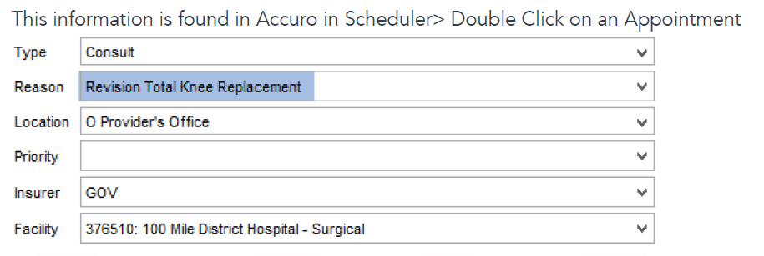
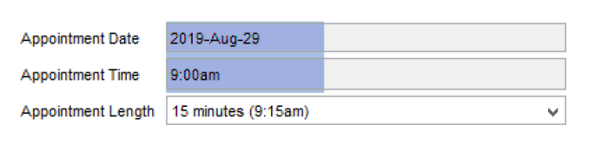
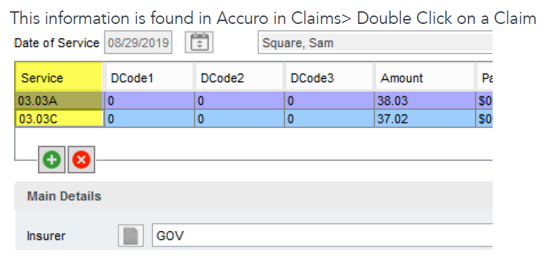
Accuro Data Mapping
Data that Maps to Alberta Netcare CED and the Healthcare Data Repository
Netcare (CED)
Healthcare Data Repository
Appointment Reason
CPAR – Central Patient Attachment Registry
Appointment Date and Time
Appointment Claim Code(s)
Notes:
CII AND CPAR MATCHING LEGEND
In the CII and CPAR project there are 3 places information will be pulled to within Alberta Health.
1. Netcare – Information is securely shared with other providers can see this information as it is published in the CII Community Encounter Digest (CED) report and copied to the Healthcare Data Repository
2. Healthcare Data Repository – Information uploaded to the Health Care Data Repository is not visible or published.
3. Central Patient Attachment Registry (CPAR) – Information uploaded to CPAR enables secured sharing of patient’s health care information with other providers in the patients circle of care and the primary provider. Data is copied to the Healthcare Data Repository.

Slide 25
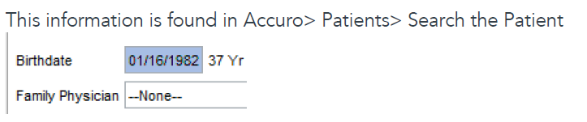

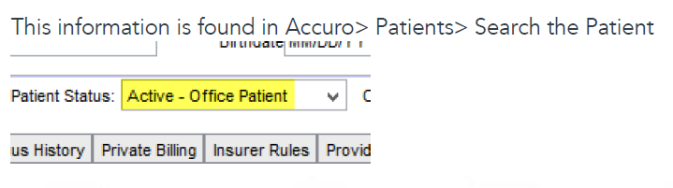
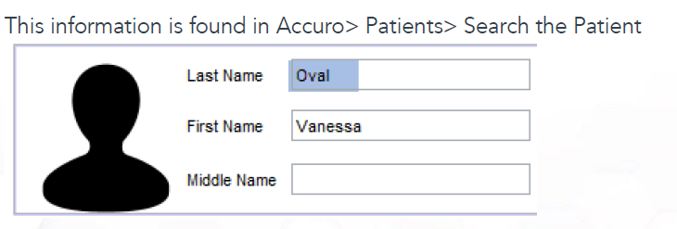
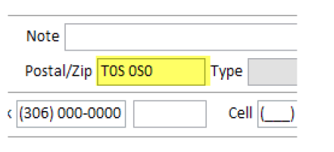
Accuro Data Mapping
Data that Maps to Alberta Netcare CED and the Healthcare Data Repository
Netcare (CED)
Birthdate
Healthcare Data Repository
CPAR – Central Patient Attachment Registry
Patient Information
Patient Status
Name
Patient Postal Code
Notes:
CII AND CPAR MATCHING LEGEND
In the CII and CPAR project there are 3 places information will be pulled to within Alberta Health.
1. Netcare – Information is securely shared with other providers can see this information as it is published in the CII Community Encounter Digest (CED) report and copied to the Healthcare Data Repository
2. Healthcare Data Repository – Information uploaded to the Health Care Data Repository is not visible or published.
3. Central Patient Attachment Registry (CPAR) – Information uploaded to CPAR enables secured sharing of patient’s health care information with other providers in the patients circle of care and the primary provider. Data is copied to the Healthcare Data Repository.

Slide 26
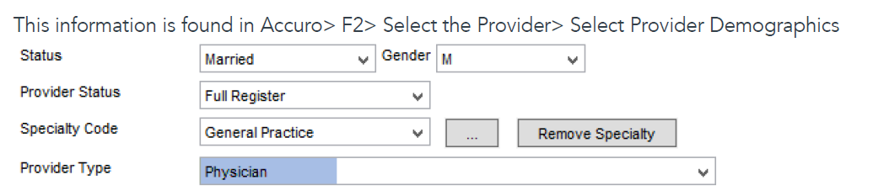
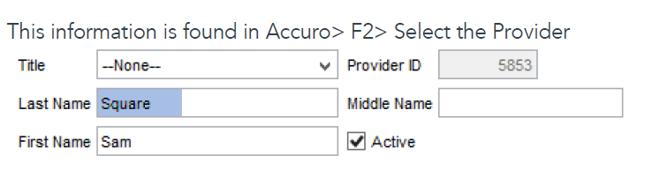
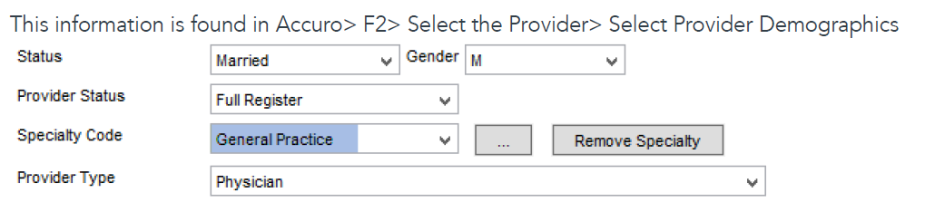
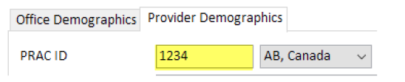
Accuro Data Mapping
Data that Maps to Alberta Netcare CED and the Healthcare Data Repository
Netcare (CED)
Healthcare Data Repository
Provider Type
CPAR – Central Patient Attachment Registry
Provider: First, Middle, Last Name
Specialty Code
Same information in different locations
Provider ID (Prac ID)
Notes:
CII AND CPAR MATCHING LEGEND
In the CII and CPAR project there are 3 places information will be pulled to within Alberta Health.
1. Netcare – Information is securely shared with other providers can see this information as it is published in the CII Community Encounter Digest (CED) report and copied to the Healthcare Data Repository
2. Healthcare Data Repository – Information uploaded to the Health Care Data Repository is not visible or published.
3. Central Patient Attachment Registry (CPAR) – Information uploaded to CPAR enables secured sharing of patient’s health care information with other providers in the patients circle of care and the primary provider. Data is copied to the Healthcare Data Repository.

Slide 27
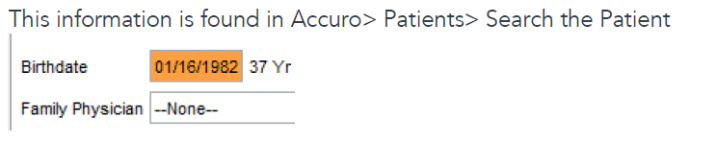
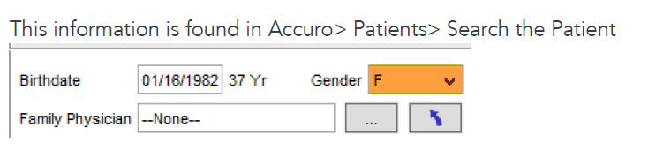
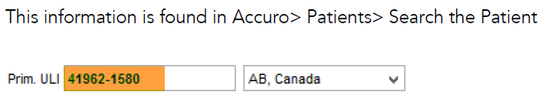
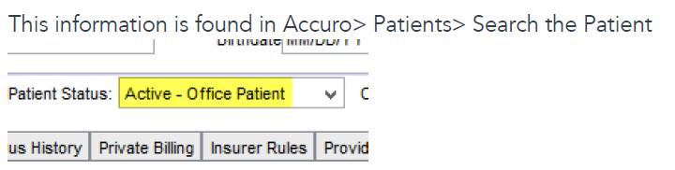
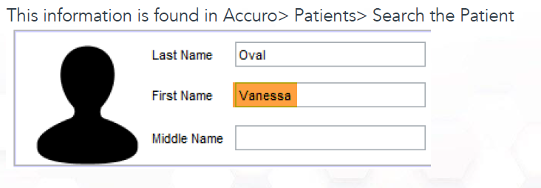
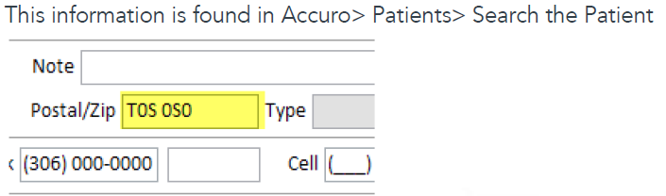
Accuro Data Mapping
Data that Maps to Alberta Netcare CED and the Healthcare Data Repository
Date of Birth
Netcare (CED)
Healthcare Data Repository
CPAR – Central Patient Attachment Registry
Gender
Patient Information: ULI
Patient Status
Name: Last, First
Patient Postal Code
Notes:
CII AND CPAR MATCHING LEGEND
In the CII and CPAR project there are 3 places information will be pulled to within Alberta Health.
1. Netcare – Information is securely shared with other providers can see this information as it is published in the CII Community Encounter Digest (CED) report and copied to the Healthcare Data Repository
2. Healthcare Data Repository – Information uploaded to the Health Care Data Repository is not visible or published.
3. Central Patient Attachment Registry (CPAR) – Information uploaded to CPAR enables secured sharing of patient’s health care information with other providers in the patients circle of care and the primary provider. Data is copied to the Healthcare Data Repository.

Slide 28
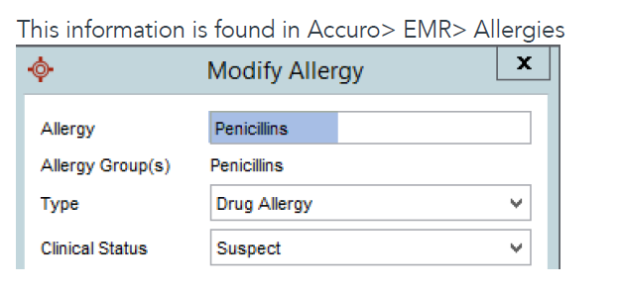
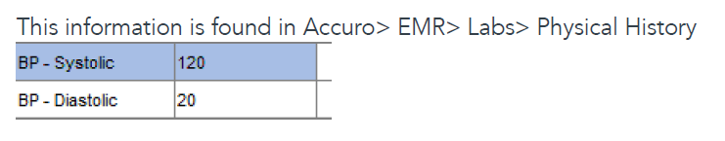
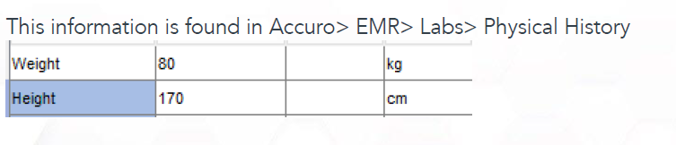
Accuro Data Mapping
Data that Maps to Alberta Netcare CED and the Healthcare Data Repository
Netcare (CED)
Healthcare Data Repository
Allergy
CPAR – Central Patient Attachment Registry
Systolic and Diastolic BP
Height and Weight and units
Notes:
CII AND CPAR MATCHING LEGEND
In the CII and CPAR project there are 3 places information will be pulled to within Alberta Health.
1. Netcare – Information is securely shared with other providers can see this information as it is published in the CII Community Encounter Digest (CED) report and copied to the Healthcare Data Repository
2. Healthcare Data Repository – Information uploaded to the Health Care Data Repository is not visible or published.
3. Central Patient Attachment Registry (CPAR) – Information uploaded to CPAR enables secured sharing of patient’s health care information with other providers in the patients circle of care and the primary provider. Data is copied to the Healthcare Data Repository.

Slide 29
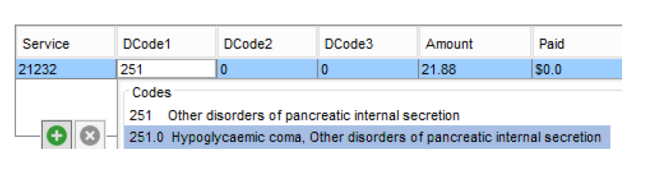
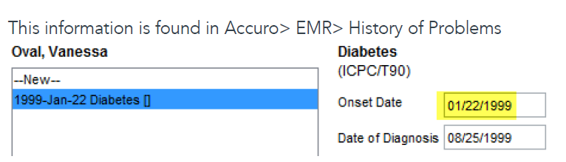
Accuro Data Mapping
Data that Maps to Alberta Netcare CED and the Healthcare Data Repository
Netcare (CED)
Observation Encounter Clinical Assessment
Healthcare Data Repository
CPAR – Central Patient Attachment Registry
Observation: Health Concern and Observation Date
Notes:
CII AND CPAR MATCHING LEGEND
In the CII and CPAR project there are 3 places information will be pulled to within Alberta Health.
1. Netcare – Information is securely shared with other providers can see this information as it is published in the CII Community Encounter Digest (CED) report and copied to the Healthcare Data Repository
2. Healthcare Data Repository – Information uploaded to the Health Care Data Repository is not visible or published.
3. Central Patient Attachment Registry (CPAR) – Information uploaded to CPAR enables secured sharing of patient’s health care information with other providers in the patients circle of care and the primary provider. Data is copied to the Healthcare Data Repository.

Slide 30
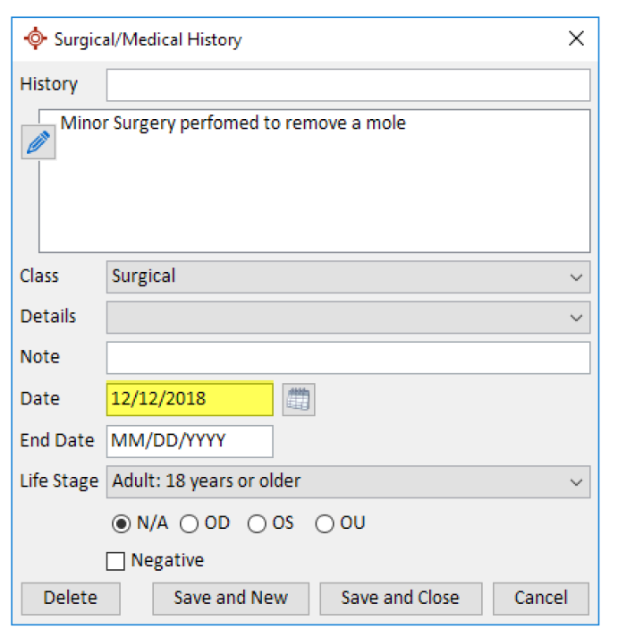
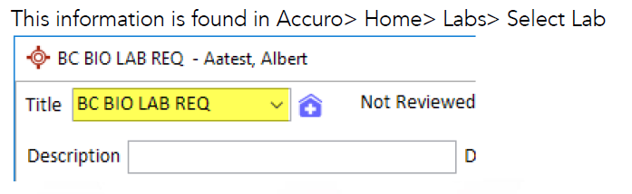

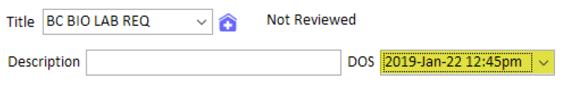
Accuro Data Mapping
Data that Maps to Alberta Netcare CED and the Healthcare Data Repository
Netcare (CED)
Healthcare Data Repository
Intervention Treatment and Date
CPAR – Central Patient Attachment Registry
Lab Request Data:
Title, Requisition Date, Order Date
Notes:
CII AND CPAR MATCHING LEGEND
In the CII and CPAR project there are 3 places information will be pulled to within Alberta Health.
1. Netcare – Information is securely shared with other providers can see this information as it is published in the CII Community Encounter Digest (CED) report and copied to the Healthcare Data Repository
2. Healthcare Data Repository – Information uploaded to the Health Care Data Repository is not visible or published.
3. Central Patient Attachment Registry (CPAR) – Information uploaded to CPAR enables secured sharing of patient’s health care information with other providers in the patients circle of care and the primary provider. Data is copied to the Healthcare Data Repository.

Slide 31
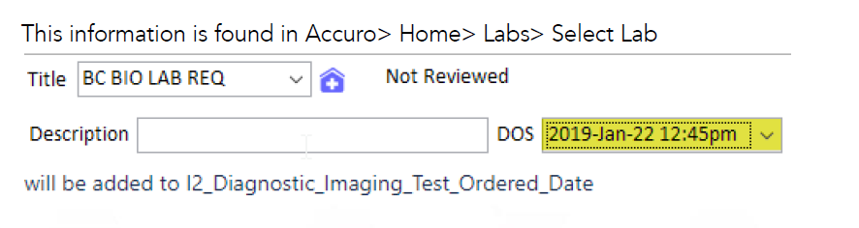



Accuro Data Mapping
Data that Maps to Alberta Netcare CED and the Healthcare Data Repository
Netcare (CED)
Healthcare Data Repository
Diagnostic Imaging Ordered and Date
CPAR – Central Patient Attachment Registry
Referral Data:
Referral Service, Referral Request Date
Immunization Data
Vaccine Name, Date and Lot
Referral Data:
Referral Date Created
Notes:
CII AND CPAR MATCHING LEGEND
In the CII and CPAR project there are 3 places information will be pulled to within Alberta Health.
1. Netcare – Information is securely shared with other providers can see this information as it is published in the CII Community Encounter Digest (CED) report and copied to the Healthcare Data Repository
2. Healthcare Data Repository – Information uploaded to the Health Care Data Repository is not visible or published.
3. Central Patient Attachment Registry (CPAR) – Information uploaded to CPAR enables secured sharing of patient’s health care information with other providers in the patients circle of care and the primary provider. Data is copied to the Healthcare Data Repository.

Slide 32
Accuro Fields to the CED
Notes:
**ANIMATED**
This slide provides a good overview of where information is pulled from in the EMR to populate the CED in Netcare.
In the “Community Encounters” Section:
**CLICK** The service delivery location pulls from the Facility field of an appointment in the scheduler
**CLICK** The provider name pulls from the Last Name and First Name fields in the Provider Demographics screen of the EMR.
**CLICK** The provider role pulls from the Provider Type field in the Provider Demographics screen of the EMR.
**CLICK** The patient reason for encounter pulls from the Reason field of an appointment in the scheduler
**CLICK** The clinician encounter clinical assessment pulls from the DCode field in the Claims section of the EMR.
**CLICK** The health concern and encounter date in “Health Concern History” section pull from the History of Problems section of the EMR.
**CLICK** The possible allergy field in the “Possible Allergy” section pulls from the Allergy field in the Allergies section of the EMR.
**CLICK** The “Measured Observations” section pulls from any BP-Systolic, BP-Diastolic, Height, Weight, and Waist Circumference labs entered in the Labs section of the EMR (or from those fields in a visit template)
**CLICK** The “Immunization” section pulls from the Immunization Summary section of the EMR.
**CLICK** The “Referrals” section pulls from the Fax Manager section of the EMR.

Slide 33

Refer to the QHR Accuro CII/CPAR Mapping and User Guides
https://actt.albertadoctors.org/PMH/panel-continuity/CII-CPAR/Pages/Tools-and-Resources.aspx

Slide 34


Keeping Records Confidential – Do Not Share Encounters
You can prevent selected health information from being sent to Alberta Netcare by making patient data private or confidential:
1. Do not share Encounter Data with CII at the patient level (ever)
2. Do not share Encounter data with CII for a single appointment
Encounter data will NOT be shared for that patient
Patient information for that appointment is NOT shared
Notes:
If a patient requests that all or part of their health information remain confidential, you can prevent selected health information from being sent by “masking” the data (making the data private or confidential).
Accuro allows users to indicate if a patient did not allow to share on two levels:
All data recorded for the patient
Data recorded for the patient for a specific appointment
More detailed instructions can be found in the “CII – Encounter Data Sharing, Clinic Workflow” section of the Accuro EMR CII/CPAR guide on the ACTT website: https://actt.albertadoctors.org/file/QHR_Accuro_CII-CPAR_Guide.pdf.

Slide 35

Consult Reports in Netcare
Consult Report
Consult Report
Community
Physician Office
EMRs
CII Data
Hub
Alberta Netcare Portal
Notes:
Key Messages:
The same patient consult report .pdf file that is sent to the referring provider can also be shared to Alberta Netcare
The specialty provider has the ability to choose which reports to upload, and which not to
The information is uploaded through the CII Data Hub and displayed in Netcare as a .pdf
Note: This information does not flow to the Healthcare Data Repository

Slide 36
Consult Reports - EMR Checklist Before Go-Live
For Providers Submitting Consult Reports:
Register for CII with eHealth Support Services.
Configure Providers for Consult Data Sharing in the Provider Wizard.
Configure your existing Consult Letters for data sharing in the Template Wizard. Consult Letters with the type Consult Report will automatically submit to Netcare.
Detailed Configuration Instructions Available in User Guide:
https://actt.albertadoctors.org/file/QHR_Accuro_CII-CPAR_Guide.pdf
Notes:
This slide outlines the steps that must be completed to enable a provider to share consult reports with Alberta Netcare.
A provider must enroll for CII with eHealth Support Services. For more information about the registration process, see the Get Started page on the ACTT website: https://actt.albertadoctors.org/PMH/panel-continuity/CII-CPAR/cii-for-specialists/Pages/Get-Started-Today.aspx
Configuring Providers for Consult Data Sharing: (these steps must be completed for each provider participating in CII)
Accuro Start Menu → Tools → Configure Providers
Select a Provider and Click Configure
Click the Next button until you get to the Affiliated Programs page
Click the add button and select “CII/CPAR – Consult Data Sharing” from the list
Click Finish to save your changes
Repeat for every Provider being set-up
Configuring your existing consult reports with a Type titled “Consult Report”
Accuro Start Menu → Tools → Template Wizard
Select an existing Consult Letter Template
In the ‘Type’ dropdown, choose ‘Consult Report’
Click Save
Repeat steps 2-4 for all Templates that should be submitted to CII
More detailed instructions can be found in the “CII – Consult Data Sharing” section of the Accuro EMR CII/CPAR guide on the ACTT website: https://actt.albertadoctors.org/file/QHR_Accuro_CII-CPAR_Guide.pdf https://actt.albertadoctors.org/file/Med_Access_CII-CPAR_Guide.pdf.

Slide 37

Sending Consult Reports to Netcare
Once configuration steps have been completed and the clinic is enabled:
Confirm “Consult Report” is the letter type.
Select attachments as you usually would.
Letters categorized as type “Consult Report” will automatically submit to Alberta Netcare
Will automatically send to Alberta Netcare when you click “Send Letter” or “Print”
Notes:
Registration in CII followed by EMR configuration in Accuro allows for consult reports to be sent to Alberta Netcare.
All letters with the Type “Consult Letter” will be sent to Alberta Netcare.
Select attachments from the EMR as you normally would. They will be included in the report shared to Alberta Netcare.
Note: When the type “Consult Report” is chosen, it is automatically sent to Alberta Netcare when you click “Send Letter” or “Print”***
***You will, however, still be required to follow the CPSA standard of practice for referral consultation. See clause 10b of the CPSA’s Referral Consultation standard of practice for more details: https://cpsa.ca/wp-content/uploads/2020/05/Referral-Consultation.pdf“. The benefit of sharing your consult report to Alberta Netcare is that it is now available to all health care providers, without the need to ‘refax’ or mail additional copies and signals to other providers that you are managing that given condition.

Slide 38

Sending Consult Reports to Netcare
Attachments can be added to your report in the usual way:
Click the green plus sign ant the bottom left of the “Attachments” area.
Select the appropriate attachments in the “Select Attachments” window that pops up.
Click “OK”.
Notes:
You can add attachments to your consult letter in the usual way:
Click the green plus sign ant the bottom left of the “Attachments” area.
Select the appropriate attachments in the “Select Attachments” window that pops up.

Slide 39

QHR Accuro – Sending Consult Reports to Netcare
Letters in Accuro categorized as type “Consult Report” are eligible for CII submission
Notes:
Registration in CII followed by EMR configuration in Accuro allows for consult reports to be sent to Netcare.
Data is submitted to CII when an encounter with a patient is recorded in Accuro, such as an appointment. The data attached to the appointment is automatically gathered and submitted to CII.

Slide 40

Consult Reports in Netcare
Standard notation is:
Specialty (as per skill code in EMR)
Consult
City/town
Other providers can see, at a glance, that this patient has a Peds Consult
Tool tip displays
Source date, category, sub-category, status, author, result source and facility
Notes:
Key Messages:
Uploaded specialist consult reports will appear in a new section in the Netcare menu “Consultations”.
Reports uploaded will appear with the date and type of consult.
Hovering over the item in the list will pop up a tool tip box with additional information
Note: Results Source for all content through CII, which goes through Netcare, indicates “AHS-Edmonton”

Slide 41
Keeping Records Confidential – Do Not Share Consult Reports
You can prevent selected health information from being sent to Alberta Netcare by making patient data private or confidential:
1. Do not share Consult Data with CII at the patient level (ever)
2. Do not share Consult data with CII for a single appointment
Consult data will NOT be shared for that patient
Patient information for that appointment is NOT shared
Notes:
If a patient requests that all or part of their health information remain confidential, you can prevent selected health information from being sent by “masking” the data (making the data private or confidential).
Accuro allows users to indicate if a patient did not allow to share on two levels:
All data recorded for the patient
Data recorded for the patient for a specific appointment
More detailed instructions can be found in the “CII – Consult Data Sharing, Clinic Workflow” section of the Accuro EMR CII/CPAR guide on the ACTT website: https://actt.albertadoctors.org/file/QHR_Accuro_CII-CPAR_Guide.pdf.
See the next slide for a third feature in Accuro that allows providers to keep consult reports private.

Slide 42

Keeping Records Confidential – Do Not Share Consult Reports (Another Option)
For consult reports not associated with an appointment, the user is able to choose ‘Do not share with CII/CPAR’ to keep the consult report from going to Alberta Netcare.
Reminder: there is the choice to make an entire visit “Do Not Share”
Notes:
This slide shows a third confidentiality feature in Accuro to not share a consult report with Alberta Netcare that is not associated with a given appointment.
3. Accuro allows a user to indicate if a Consult Report, not associated with an Appointment, is not to be shared with CII.
More detailed instructions can be found in the “CII – Consult Data Sharing Clinic Workflow” section of the Accuro EMR CII/CPAR guide on the ACTT website: https://actt.albertadoctors.org/file/QHR_Accuro_CII-CPAR_Guide.pdf.

Slide 43





Confirmed Panel Lists to CPAR
Demographic Mismatch Report
Community
Physician Office EMR
CII Data
Hub
Central Patient
Attachment Registry
Panel Conflict Report
Confirmed Panel Lists
Healthcare Data
Repository
Notes:
Key Messages:
The third type of information shared are confirmed panel lists.
Panels are uploaded to CPAR and to the Healthcare Data Repository
Participating clinics receive back two reports:
The demographic mismatch report, that displays deceased patients and those whose demographic data does not match the provincial client registry.
The panel conflict report that displays paneled patients on the submitting provider’s panel that are also on other submitting providers panels. It displays the patient information plus the date of last visit and the last date of confirmation for the conflicting providers.
Identifying these conflicts will give providers a better picture of their panel and where care might be duplicated.
It will also enable conversations with patients about the benefits of continuity and the risks of seeing multiple providers.

Slide 44

Accuro CPAR Mapping – Patient Demographics
Patient Demographics – Mapping to CPAR
Information that to submits to CPAR:
Name (first, last)
DOB
Gender
PHN
Office Provider
Last Date Verified
Last Visit Date pulls from scheduler
Panel number in provider record
Notes:
NOTE: in Accuro, the name of the primary provider is from the Office Provider field, not the Family Physician field
CII AND CPAR MATCHING LEGEND
In the CII and CPAR project there are 3 places information will be pulled to within Alberta Health.
1. Netcare – Information is securely shared with other providers can see this information as it is published in the CII Community Encounter Digest (CED) report and copied to the Healthcare Data Repository
2. Healthcare Data Repository – Information uploaded to the Health Care Data Repository is not visible or published.
3. Central Patient Attachment Registry (CPAR) – Information uploaded to CPAR enables secured sharing of patient’s health care information with other providers in the patients circle of care and the primary provider. Data is copied to the Healthcare Data Repository.

Slide 45

CPAR Panels – EMR Checklist Before Go-Live
For Providers Submitting Panels:
Add panel numbers in “Configure Providers”
Assign panel number to provider
Check off Active on Panel for patient statuses to be included in CII/CPAR panel
Detailed Configuration Instructions Available in User Guide:
https://actt.albertadoctors.org/file/QHR_Accuro_CII-CPAR_Guide.pdf
Notes:
There is one-time set-up in each EMR.
The project has found that, unless the clinic is using the EMR is a non-conventional way, that there is little interruption in workflow.
Depending on the steps to complete a consult report and who is involved, there may need to be discussion on who presses the “Send to Netcare” button

Slide 46
Conditions that allow Panels to flow from Accuro to the CPAR
Panels are automatically created and submitted based on the following criteria:
Provider has a CPAR Panel Number recorded in Accuro
Provider has a PRACID recorded in Accuro
Patients are attached to a provider’s panel based on the following criteria:
Patient is linked to the provider (via ‘office provider’ field)
The patient’s status is of a type that is categorized as ‘Active on CII/CPAR Panel’
Patient has a Last Visit date (with any provider in the practice)
Detailed Configuration Instructions Available in User Guide:
https://actt.albertadoctors.org/file/QHR_Accuro_CII-CPAR_Guide.pdf

Slide 47

Panel Tip – Review your Panel Before Submission
Prior to the 12th of each month review each provider’s panels
The clinic EMR administrator can provide access to the clinic CPAR Panel Administrator (PA) to review panels monthly in Accuro before submitting*
Tip for clinic Panel Admin
  Navigate from the Accuro Start Menu > Submit CII/CPAR Panels
  Choose the Panel from the Panel Number field
  View the Patient Details for each panel
    Included in submission
    Ignored in submission
    Duplicate Patient Data
*See detailed instructions in Accuro CII/CPAR User Guide Page 10

Slide 48


Uploads and Reports
CPAR panel conflict reports available by the 2nd of the month
QHR uploads automatically on the 12th of the month. Upload error reports available next day. Demographic mismatch reports available in 2 days.
2
12
14
CPAR starts to find overlap amongst all submitted panels. No uploads between the 22nd and last day of the month.
21
22

Slide 49
Reports Available for Download
1. Conflict report
Identifies patients paneled to more than one provider
Compares dates of confirmation and dates of last visit for the providers the patient is paneled to
Notes:
The two reports a PA will receive from CPAR include the Conflict Report which shows attachment conflicts between the primary provider and any other providers that the patient has been paneled to and confirmed. It identifies last visit date and confirmation dates for both/all providers and it identifies the conflicting provider and facility.

Slide 50


Reports Available for Download
2. Demographic Mismatch Report
Identifies deceased patients
Patients where demographic data is different from the Provincial Client Registry
Notes:
The two reports a PA will receive from CPAR include the Conflict Report which shows attachment conflicts between the primary provider and any other providers that the patient has been paneled to and confirmed. It identifies last visit date and confirmation dates for both/all providers and it identifies the conflicting provider and facility.

Slide 51


CII/CPAR Overview Future State
Community Physician Offices
Provincial IT Systems
* Clinical Encounter Digests
* Specialist Consult Reports
* Patient Summary Reports
Patient Data
Uploaded
to Hub
Patient Data/Reports
Uploaded to Provincial
IT Systems
CII Data
Hub
* Clinic Encounters
* Patient Panels
* Specialist Consult Reports
* Patient Summary Reports
Alberta Netcare
* Patient Panel Data
Notifications
Downloaded
to Clinic EMRs
Central Patient
Attachment Registry
Patient
Summary
Uploaded
to MyHealth
Panel Data Extracted
* E-Notifications
Hospital Admit/Discharge
Emergency Department Visits
Day Surgery
* Clinical Encounter Data
* Patient Panel Data
* Patient
Summary
Reports
Healthcare Data
Repository
MyHealth Records
Notes:
Key Messages:
New functionality will be added to CII/CPAR in the near future
ENotifications are expected for Accuro in early 2022
In the planning stages is the Patient Summary Report. Physicians will have the opportunity, within their EMR, to curate a patient summary that will offer a more complete picture of the patient. These summaries will upload to Alberta Netcare so other providers in the patients circle of care will have more complete information.

Slide 52

eNotifications
Team members with lab results access can see eNotifications
Schedule:
QHR Accuro - 2022
Notifies primary provider when a CPAR paneled patient has an ED discharge, hospital admission or discharge, or day surgery discharge
Notifications appear similar to lab reports in the EMR
Notifications are delivered twice daily at 6 am and 2 pm
Info includes:
Pt demographics
Facility location
Date/time
Attending provider
Admission reason
Additional providers notified
If the patient becomes deceased in ED or hospital, it will indicate (Deceased) or (Deceased, YYYY, MM, DD) beside the patient’s name.
If a patient is paneled in CPAR to more than one provider both providers receive the eNotification.
https://actt.albertadoctors.org/cii-cpar/toolsresources
Notes:
Key Messages
eNotifications are automated messages delivered directly into the physician’s Electronic Medical Record (EMR), with information about key healthcare events for paneled patients
Alerts for an ED visit, hospital admission or discharge or a day surgery
The summary provides additional information
Expected for Accuro early 2022
eNotifications are expected for Wolf in Q1 2020, Med Access follows the PS Suite. QHR Accuro is expected later this year.
A notice is received in the provider’s lab report tab and stored in the patient chart
Alerts for an ED visit, hospital admission or discharge or a day surgery
The summary provides additional information
Note: With eNotifications being enabled, there is new information in the Team Toolkit.
See also information sheet for eNotifications on the website.

Slide 53



Additional Information About eNotifications
https://actt.albertadoctors.org/cii-cpar/toolsresources
Notes:
You can also find additional information on managing eNotifications, by referring to the eNotifications Info Sheet shown here and linked to in the notes below.
For example, if a provider decides that they would like to follow-up with a patient about an incoming eNotification, they should first check Netcare for additional information. For instance, Netcare may inform the provider that the patient has passed away or successfully delivered their baby. This is valuable information to have before contacting a patient.
It is also important not to assume a positive outcome when following up with a patient.

Slide 54

More Information and Resources
https://actt.albertadoctors.org/cii-cpar/toolsresources
Notes:
So that is where we are at for the mapping information and functionality for CII/CPAR and eNotifications for the PS Suite EMR. Please remember to visit our website for more detailed guides and instructions.

Slide 55



Benefits of CII/CPAR
PATIENT
PROVIDER
PCN
HEALTH SYSTEM
Better Quality of Care:
Meets patient expectations to have their information readily available to all providers in their circle of care
More coordinated and consistent care
Smoother transitions of care
Less story telling
Less duplication of care
Less time in hospitals
Increased patient safety
Increased satisfaction
Relational Continuity:
Clearer picture of the primary provider’s panel
Ability to deliver better care
Informational Continuity:
Healthcare information available where and when it’s needed
Management Continuity:
Facilitates planning and delivery of more intensive interventions
Time savings:
Patient health care record more complete
Enable PMH Implementation
Panel and Continuity
Care Coordination
Build the Foundation:
Reporting
Quality Improvement
Analytics
Aggregate data for health service planning
More Efficient Care:
Lower healthcare costs
Less utilization
Better Decisions:
Secondary use supports health system planning
More informed program planning
Notes:
There is value in CII/CPAR for Patients, Providers, PCN and the Health System

Slide 56
Participation Readiness

Slide 57

Prerequisites to Participate in CII
The clinic must be live on Alberta Netcare Portal
The clinic must have an EMR Privacy Impact Assessment (PIA)
    Support is available to review and make recommendations to bring your PIA up to date, if required
Providers must be panel ready
Using a conformed EMR:
    Microquest Healthquest*
    QHR Accuro*
    TELUS Med Access, PS Suite or Wolf
    *Requires latest version
PIA
Microquest
QHR
TELUS
Notes:
For clinic to participate in CII:
Must be enabled on Alberta Netcare
The clinic must have an EMR PIA
Providers with panels must be panel ready
The EMRs that work with CII are from Microquest, QHR and Accuro. If using a locally installed version of Accuro or Healthquest, the vendor will work with the clinic to ensure they are using the most recent version.

Slide 58


1. Live on Alberta Netcare Portal
The clinic site must be live on Netcare.
If the clinic is not live, please visit the Alberta Netcare website to learn more about registering for Alberta Netcare:
http://www.albertanetcare.ca/Registration.htm

Slide 59




2. Clinic PIA must be up-to-date
1. Complete the PIA Update Self-Assessment
2. Supports to update clinic Privacy Impact Assessment
OIPC Guide
Privacy Seminar Recording
http://www.albertanetcare.ca/learningcentre/trainingrecordings.htm
eHealth Support Team
Notes:
When clinics submit Confirmation of Participation, eHealth Privacy team will undertake a review of the privacy information provided by the site. They will provide guidance should it be identified updates need to be made. It is a best practice to have an up to date PIA, not just for CII/CPAR but any other initiative that may be undertaken, PrescribeIT, RTI, Netcare etc.
Where to start when updating a PIA?
Complete the PIA Update self-assessment available on the CII/CPAR Tools and Resources Page in the Privacy section: https://actt.albertadoctors.org/cii-cpar/toolsresources
eHealth Support Services will undertake a review of the PIA
To get advice on updating the PIA access the Privacy Seminar Recording available on the Alberta Netcare Learning Centre
http://www.albertanetcare.ca/learningcentre/trainingrecordings.htm

Slide 60
Minor or Major PIA Update?
The PIA Update Self-Assessment will assist in determining if you need to update your PIA.
Potential PIA Updates Triggers: Common Examples
  EMR system change
  EMR change from local to “in the cloud”
  New EMR user access role or group introduced
  Adding EMR access to an organization not in your PIA
  New ways of communicating with patents (e.g., email, text messages)
  Adding wireless access to EMR
  Adding remote access to EMR
  Adding new device access to EMR (e.g., mobile, tablets, laptops)
  Minor change/update
  Update clinic privacy policy and procedures (e.g., 2018 breach reporting requirement)
PIA Update Self-Assessment
Notes:
The PIA Update Self-Assessment will assist the clinic in determining if a minor or major update is ahead for the clinic. This tool is provided as a guide and it is recommended that a member of the clinic complete it at submission of the confirmation of participation (COP) form. Once the CoP form is submitted to Alberta Health eHealth Support Services an eHealth consultant is assigned to the clinic and one of the first activities is that an eHealth privacy consultant will go over this assessment with the clinic. They will provide guidance.
Examples of actions that would likely lead to a major PIA update would be:
EMR system change
EMR change from local to “in the cloud”
New EMR new user access role or group introduced
Adding EMR access to an organization not in your PIA
New ways of communicating with patents (e.g., email, text messages)
Adding wireless access to EMR
Adding remote access to EMR
Adding new device access to EMR (e.g., mobile, tablets, laptops)
See the assessment tool itself for details.

Slide 61



Questions about Privacy?
Privacy Tools
Privacy and Security FAQ
Summary of Key Privacy Info
CII PIA Summary
Notes:
These tools are available on the CII CPAR Tools and Resources Page: https://actt.albertadoctors.org/cii-cpar/toolsresources

Slide 62








CII/CPAR falls under the Alberta Netcare umbrella, which is covered by the Health Information Act. Providers are not required to
have direct conversations with their patients, however…
About Privacy…
Health Collection Poster
they are obligated to place a Health Collection Notice poster within a patient’s view. A customizable template is provided to the clinic.
Patient Brochure
If patients have further questions, CII Patient Brochures are also provided.
?
Custodian & Clinic Script
A Custodian and Clinic Script for Patients is provided which outlines how to discuss patient’s expressed wishes and the use of confidential flags.
Patient FAQ
The Patient Frequently Asked Question (FAQ) document explains the CII/CPAR initiative and its implications to patients of CII/CPAR clinics. It also provides patients with contact details* if they have more questions.
Privacy & Security FAQ
The CII/CPAR Privacy & Security FAQ further details
the sharing of health information.
Health
Collection
Poster
* eHealth Netcare Support Services at 1-855-643-8649 or ehealthsupport@cgi.com
Notes:
Participants in CII CPAR will have a health collection poster to post in their clinic. Use the new poster to replace the existing Netcare poster. A provider/clinic is not obligated to inform each patient, beyond posting the Health Collection Notice.
If patients have questions there is a brochure.
If a patient has questions beyond the brochure, there is a team script.
If the patient still has more questions there is an FAQ with a 1-800 number.
In the end, the patient has two options. The patient can have their information flagged as confidential at the clinic or they have the option of having their record masked in Alberta Netcare. Few Albertans have chosen to have their record masked in Alberta Netcare.
The Health Collection Notice poster may be downloaded from the CII/CPAR Tools and resources page: https://actt.albertadoctors.org/PMH/panel-continuity/CII-CPAR/Pages/Tools-and-Resources.aspx See other languages available.
Physician offices may take the poster as a template and customize it to their clinic.
There is an obligation under the Health Information Act to notify patients about collection of health information. If a provider wants to include it on a registration form instead of a poster, they are able to have flexibility with HOW patient notice is given.

Slide 63



Privacy: Patient Tools
CII Patient Brochure
Custodian and Team Script
Patient FAQ
Notes:
These tools are available on the CII CPAR Tools and Resources Page: https://actt.albertadoctors.org/cii-cpar/toolsresources

Slide 64


3. Panel Ready* – Panel Readiness Checklist
All boxes must be checked off on the panel readiness checklist
*Panel readiness does not apply to providers that will participate and submit encounters and/or consult reports but no panels.
Notes:
Clinics that participate in CPAR must be panel ready, in other words, have established processes in place to identify and maintain their panels.
These tools are available on the CII CPAR Tools and Resources Page: https://actt.albertadoctors.org/cii-cpar/toolsresources

Slide 65
What Must Physicians Do?
What is Optional?

Slide 66





CII/CPAR Physician Experience – Pre Go-Live
Physician(s) Required Activities
Physician Optional Activities
Clinic identifies team member to be Site Liaison (usually clinic manager)
Receive information about CII/CPAR including mapping in the EMR
Decide to participate in CII/CPAR
PIA
Meet with clinic manager/ privacy officer about PIA
Sign participation forms and AH PIA endorsement letter
Meet with PCN facilitator
Notes:
All participating physicians must review the CPAR information and mapping in the EMR (this presentation).
Once a decision has been made to participate, forms must be signed including the AH PIA endorsement letter.
Activities that may involve a physician, but do not have to, include:
Identify a clinic site liaison
PIA update work may involve the clinic privacy officer or a physician custodian at the clinic
One or more physicians may choose to meet with the PCN facilitator about CII/CPAR

Slide 67




CII/CPAR Physician Experience – Post Go-Live
Physician(s) Required Activities
Physician Optional Activities
Provider or delegate views CEDs in Netcare for quality assurance
CII
CPAR
Go Live
Review panel conflict report and give feedback
Optional evaluation
Receive eNotifications when CPAR patients are in hospital or ER; advise on team process
Provider may participate in quality improvement meetings
Notes:
After go live a physician must:
Review their monthly panel conflict report and give direction to the team on priorities
Receive eNotifications (when enabled and signed up for) for CPAR paneled patients that have had a hospital admission or discharge, ED visit or day surgery. The clinic team should establish team workflow for these notifications at the direction of the primary provider
At go-live and periodically thereafter, a provider or delegate view the CEDs in Netcare as feedback on clinic documentation and presentation in the CED. A behaviour that can support this is activity is to view the CED of frequent clinic visitors after go live
It is optional for physicians to complete the CII/CPAR Evaluation
Physicians may participate in team QI meetings; these may be led by one clinic physician, depending on the QI model at the clinic

Slide 68
Ready to Participate?

Slide 69

The Clinic Journey
Registration and Participation: For Clinics with Panels
Notes:
This is the process for clinics with panels.
Registering for CII/CPAR is a lot like registering for Netcare. For clinics that will be submitting panels and encounters, there are 5 forms to be completed. Approximate processing times are on the slide.
The time it takes for sites to obtain signatures and submit forms to eHealth is not included in the estimated times
Each form includes an instructions page to assist with completion. The electronic forms MUST be completed on computer, not printed and completed by hand.
For clinics only submitting encounters and/or consult reports there are only two forms: the Confirmation of Participation form and CII PIA Endorsement Letter, see next slide

Slide 70

The Clinic Journey – Registration & Participation
(for Participants Submitting Encounters and/or Consult Reports)
Confirmation of Participation Form
Participation Package
Notes:
This is the process for clinics without panels that will submit encounters and/or consult reports. It all starts with completing the Confirmation of Participation form:
https://actt.albertadoctors.org/file/Confirmation_of_Participation_Specialists.pdf
Once eHealth has received the CoP form, the next step is the participation package including the endorsement letter for the CII PIA filed by Alberta Health with the OIPC. Reference next slide for who completes the endorsement letter.

Slide 71


Ready to Complete the Confirmation of Participation Form?
CPAR Roles and Responsibilities
Part A: Gather Clinic Information
Decide who will be the clinic Site Liaison (and alternate)
Part B: Clinic Readiness
Respond to questions
Part C: Identify Participating Providers
Providers with panels upload
panels and encounters
Providers who write consult reports upload consult reports
Providers with panels can sign up for eNotifications when enabled
See Team Toolkit Appendix C
Notes:
To get the process started, submit a Confirmation of Participation form. The form is filled in electronically (not printed and filled by hand) You do not have to have all of the prerequisites in place, particularly an up to date PIA. As long as you’re working towards getting the prerequisites in place please go ahead and submit the COP form. This way eHealth support services will know you’re in the queue and can provide some guidance and support.
In Part B – clinic can still submit the COP form even if the answer is not Yes in Part B. The eHealth Support Services team will provide assistance.
https://actt.albertadoctors.org/cii-cpar/toolsresources
The COP form is available on the CII CPAR Tools and Resources Web Page https://actt.albertadoctors.org/cii-cpar/toolsresources
E-notifications sign-up is on this form. It will be enabled for TELUS EMRs in 2020.

Slide 72

Confirmation of Participation Form – Page 2
Part D: Clinic Governance
Is there a primary custodian at the clinic?
Part E: Provider Awareness and Agreement
Confirm provider awareness
Part F: Training Confirmation
Providers reviewed privacy materials
Team is aware of roles and responsibilities
EMR mapping to Netcare understood
Panel readiness checklist (for panel clinics only)
Note: Page 3 of the Confirmation of Participation Form provides detailed instructions.
Notes:
Parts E&F: We have prepared presentations that can be shared with clinic teams to satisfy the requirements of these sections
Instructions on page three of the form provide additional information.

Slide 73
Pre Go-Live Tips
Tools and Supports
https://actt.albertadoctors.org/cii-cpar/toolsresources

Slide 74

Next step for the clinic Site Liaison
Team Toolkit
Notes:
The Team Toolkit is the next logical resource to be used by the clinic site liaison. The PCN resource supporting the clinic will also be using this toolkit.
These tools are available on the CII CPAR Tools and Resources Page: https://actt.albertadoctors.org/cii-cpar/toolsresources
The Team Toolkit is updated almost Monthly. It contains information to prep for eNotifications.

Slide 75

Use the Clinic Journey Checklist for each step
The Clinic Journey Checklist
https://actt.albertadoctors.org/cii-cpar/toolsresources
Notes:
Anita
These tools are available on the CII CPAR Tools and Resources Page: https://actt.albertadoctors.org/cii-cpar/toolsresources
Or
https://actt.albertadoctors.org/PMH/panel-continuity/CII-CPAR/Pages/Tools-and-Resources.aspx

Slide 76
More Information and Resources
https://actt.albertadoctors.org/cii-cpar/toolsresources

Slide 77
Information Sharing Questions?
What if I add a diagnosis or assessment that is incorrect?
Disclaimer: This document lists the patient’s encounter information from participating clinics. It does not represent the patient’s medical history or summary. Provider must verify the accuracy and completeness of this patient’s information prior to treatment decisions.
By accessing Alberta Netcare, users agree to the Term of Use and Disclaimer. Information is “as is”.
Providers must use their clinical judgement.
Notes:
A provider may be reluctant to participate in CII/CPAR in the rare occurrence that an assessment is made in a visit that is incorrect and included in the Community Encounter Digest.
Like the Term of Use and Disclaimer for Netcare, the Community Encounter Digest, also has a disclaimer that the using provider must verify accuracy and completeness prior to treatment decisions.
Sharing of information with others in a patient’s circle of care is crucial to close the informational continuity care gap. It will not always be perfect and relies on the clinical judgement of the user.

Slide 78

Questions
& Next
Steps

Slide 79
?
http://www.albertanetcare.ca/learningcentre/CII.htm
https://actt.albertadoctors.org/CII-CPAR/cii-cpar-primary-care/Pages/CII-CPAR-for-Primary-Care.aspx
https://actt.albertadoctors.org/CII-CPAR/Pages/Tools-and-Resources.aspx
Let your PCN know that you are interested in participating in CII/CPAR.

