Slide 1


Technology for Integration and Continuity
Orientation for Primary Care Clinics Using Microquest Healthquest
Version: June 2021

Slide 2
Sections
Section | Slides
Where did CII/CPAR come from? | 3
Why CII/CPAR? | 4-8
What are CII/CPAR? | 9-13
How do they work? | 14-20
Data Mapping - Encounters | 21-30
EMR Confidentiality | 31-32
Sending Consult Reports | 33-38
Sending Panels to CPAR | 39-43
Future State | 44
eNotifications | 45-46
Benefits of CII/CPAR | 47
Readiness Criteria | 48-56
What must physicians do? What is optional? | 57-59
Next steps once you’re ready | 60-64
Pre Go-Live tips | 65-70

Slide 3




CII and CPAR were at the Request of Physicians
The Central Patient Attachment Registry was at the request of Family Medicine (SGP at the time).
A commitment was made to build this tool for primary care.
Alberta’s community specialists requested technology to submit consult reports to Netcare (CII) at AMA Rep Forum.
Partners:
Notes:
Key Messages:
October of 2016 the Amending Agreement was ratified between Alberta Health and the AMA.
CII/CPAR is something physicians have been asking for.
Commitment from both parties to develop the Central Patient Attachment Registry as a tool for primary care and a key technical enabler for continuity of care.
In the summer of 2018 the AMA, AHS and AH agreed to merge the two projects of Community Information Integration and CPAR with enhanced value components for continuity.
The ability to upload consult reports to Netcare, CII, was a resolution from specialists at AMA representative forum.
Key point – this has been at the request of physicians.

Slide 4
Why Technology for Integration
& Continuity?

Slide 5
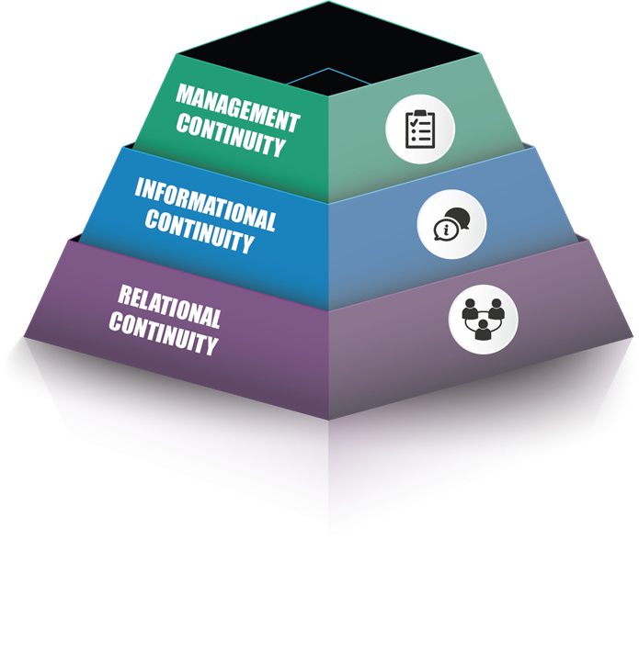
Continuity Defined
Relational continuity is defined as:
The ongoing, trusting therapeutic relationship between a patient and a primary care physician and their team, where the patient sees this primary care physician the majority of the time
Continuity of Care: a multidisciplinary review,
JL Haggerty et al, 2013
Notes:
Expanded Definition of Continuity (that encompasses all 3 types of continuity):
Continuity in primary care is mainly viewed as the relationship between a single primary care provider and a patient that extends beyond specific episodes of illness or disease. It implies quality care over time (as experienced by the individual patient) and the linking of information and providers across different events. For continuity to exist, care must be experienced as connected and coherent.
Relational continuity is defined as:
The ongoing, trusting therapeutic relationship between a patient and a primary care physician and their team, where the patient sees this primary care physician the majority of the time

Slide 6
Rationale/Benefits
Evidence shows that when a patient has a continuous relationship with a primary provider and care team, the overall result is better than when care is disjointed or broken
Higher continuity is associated with improved health, quality of life, and reduced mortality
Notes:
CII/CPAR is about improving continuity of care. This is NOT about telling patients they can only receive care from one physician. Patients have the right and need to receive care as required including having a regular family doctor and going to walk-in clinics as needed.
Research reveals that a consistent relationship between patients and their family doctor and team can make a big impact on health. Seeing the same family doctor can lead to higher quality of care than seeing a different doctor and team each time. Studies show that people who know and trust their healthcare providers have lowered risk of chronic disease and early death.

Slide 7
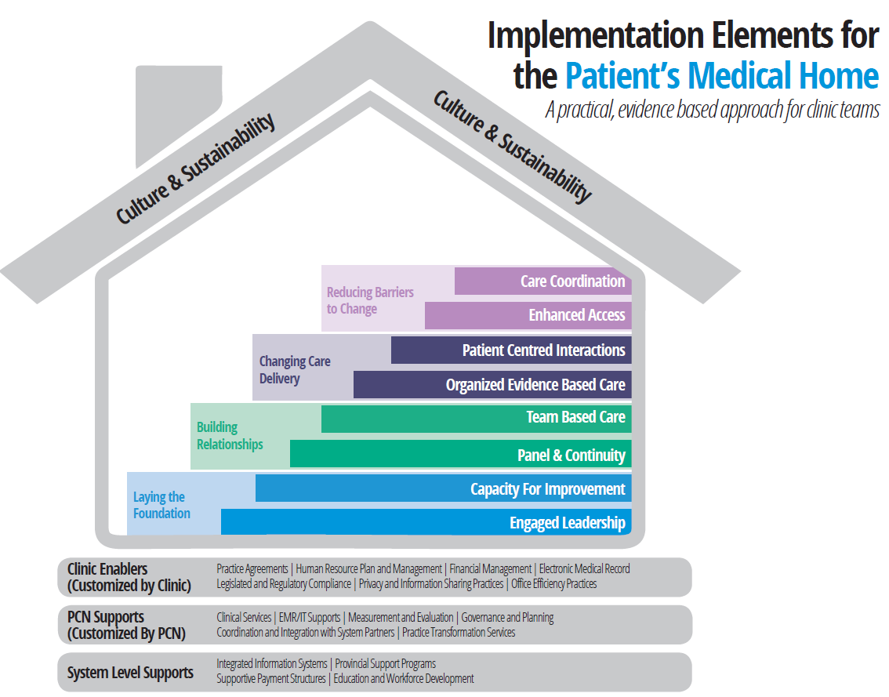


CII/CPAR Alignment with PCN Initiatives
Patient’s
Medical
Home
Transitions of Care
Continuity
Of
Care
Opioid Response
Notes:
CII/CPAR is in direct alignment with PCN initiatives:
Continuity is a critical goal of Patient’s Medical Home (PMH), and one of the eight evidence-based implementation elements that guide the PMH journey in Alberta.
CII/CPAR will support transitions of care with the identification of the primary provider in Netcare. E-notifications will enable smoother transition of care and can even assist in the opioid response
(Example re opioid; when enabled, primary providers will receive an e-notification after day surgery. Currently many providers are unaware when surgery such as knee replacement occurs and are not notified to provide early follow-up with a patient at risk of addiction).

Slide 8
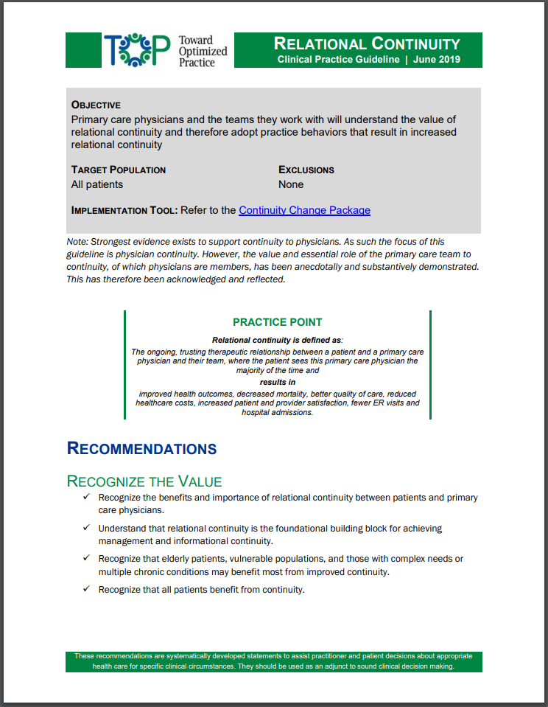
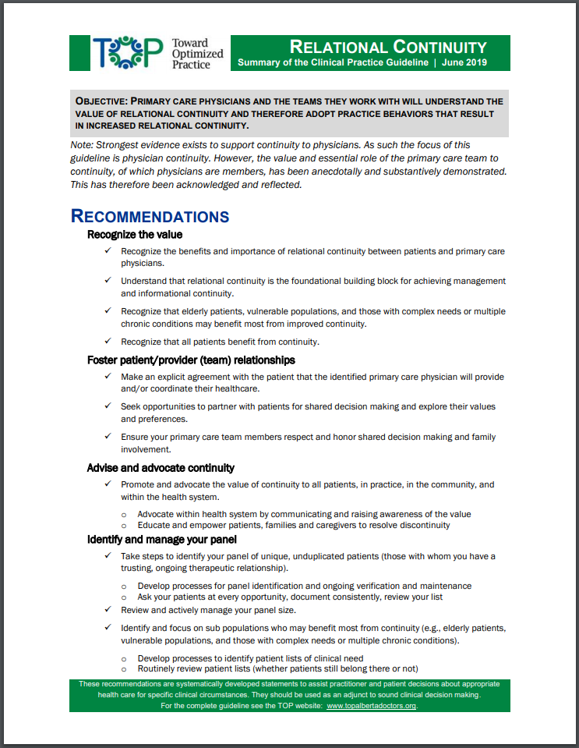
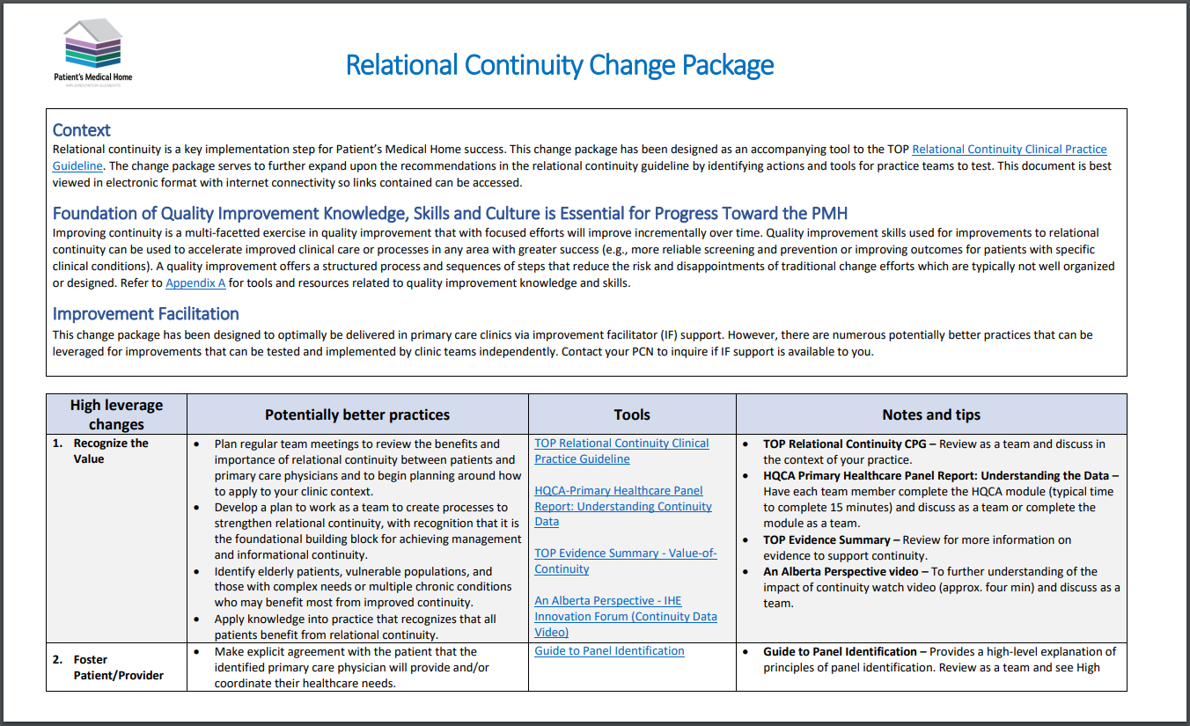
New TOP Relational Continuity CPG
June 2019
Change Package
Guideline
Summary
Notes:
Angille
OBJECTIVE: PRIMARY CARE PHYSICIANS AND THE TEAMS THEY WORK WITH WILL UNDERSTAND THE VALUE OF RELATIONAL CONTINUITY AND THEREFORE ADOPT PRACTICE BEHAVIORS THAT RESULT IN INCREASED RELATIONAL CONTINUITY.
Note: Strongest evidence exists to support continuity to physicians. As such the focus of this guideline is physician continuity. However, the value and essential role of the primary care team to continuity, of which physicians are members, has been anecdotally and substantively demonstrated. This has therefore been acknowledged and reflected.
CPAR is an enabler for relational continuity

Slide 9
What are CII and CPAR?

Slide 10
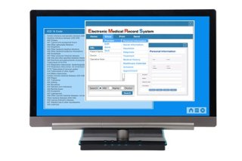
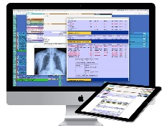


What is Community Information Integration (CII)?
CII is a system that collects select patient information from community Electronic Medical Records (EMRs) and shares it with other members of the patient’s care team through Alberta Netcare.
Alberta Netcare Portal
Community
Physician Office
EMRs
CII Data
Hub
Healthcare Data
Repository
Notes:
Key Messages:
CII is designed to allow information to flow from community physician EMRs to other areas of the health care system so that the information can be used to deliver better care.
Initially information will flow to Aberta Netcare to be used by other health professionals; for example, through CII, if a patient has to go to the Emergency Department, the care providers will have access to the information from the patient’s medical home and specialist consult reports.
Information will also flow to the Healthcare Data Repository at Alberta Health to be used for population health quality improvement activities

Slide 11
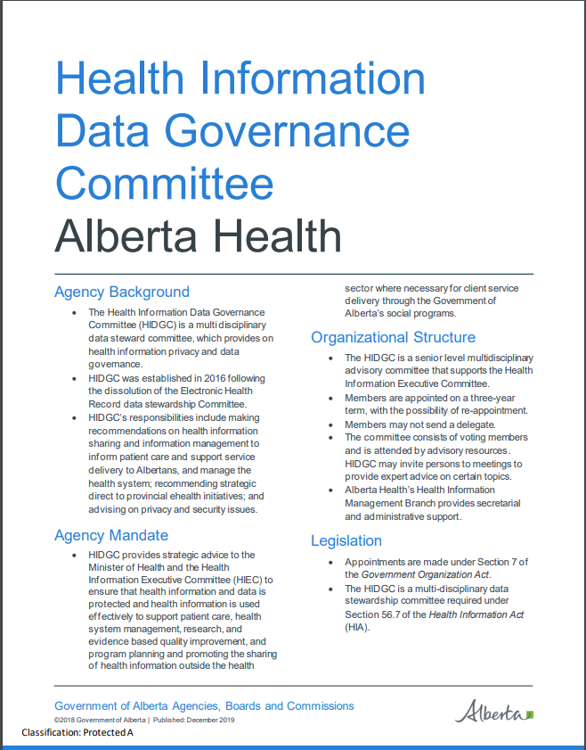
Health Information Data Governance Committee (HIDGC)
Use of the information in CII/CPAR is governed by the Health Information Data Governance Committee (HIDGC)
Senior level, multidisciplinary data stewardship committee of Alberta Health
Alberta physicians are represented by members representing:
  Alberta Medical Association
  College of Physicians and Surgeons
  Faculties of Medicine
  CPSA Registrar
Other non-government members represent pharmacists, nurses and the public
https://actt.albertadoctors.org/file/HIDGC_Overview_Fact_Sheet.pdf
Notes:
Key Messages:
The Healthcare Data Repository is a database created by Alberta Health to gather information from across the healthcare system including community EMRs
So new that it contains limited information that isn’t currently being used at all
The only people who currently have access are technicians responsible for making sure everything is operating properly
Alberta health will ”use this information within its data analytics systems to perform such activities as planning, quality improvement and health system management.” (PIA summary page 4)
All high performing health care systems have this capability, Alberta is aligned with this
Use of this information for system improvement will benefit everyone – efficiency, cost savings, better resource allocation, better outcomes (???)
This system is not intended or designed to be used for performance management
The data collected for the HDR is similar to data collected for billing, but not the same; and of course collected for a different purpose. Billing data is not available for the kind of analytics needed for sophisticated health system management
There is GOVERNANCE!
The Health Information Data Governance Committee is responsible for making recommendations on how the data may be used

Slide 12
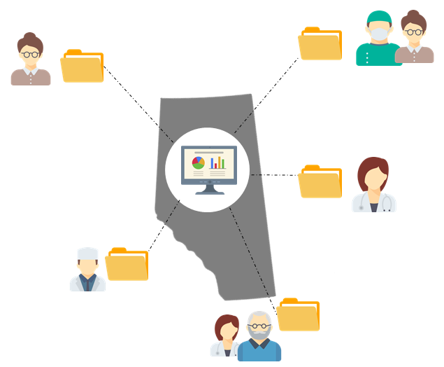
Central Patient Attachment Registry (CPAR)
A provincial system that captures the confirmed relationship of a primary provider and their paneled patients.
Receives information automatically from clinic EMRs on a monthly basis
Next logical step for practices that have invested in panel management
Foundational for enhancements of informational continuity such as eNotifications
Notes:
Key Messages:
CPAR supports new processes so that family doctors and teams can confirm their relationships with patients and share it through Alberta Netcare. This will help reinforce the consistent relationships between patients and their providers.
Panels will be uploaded monthly, automatically, from clinic EMRs. This monthly capture is needed because panels are fluid. They change as patients are born, pass, join the practice and leave the practice.
Panel information in the registry is crucial to future enhancements in Alberta. It is the source of truth of panel.

Slide 13
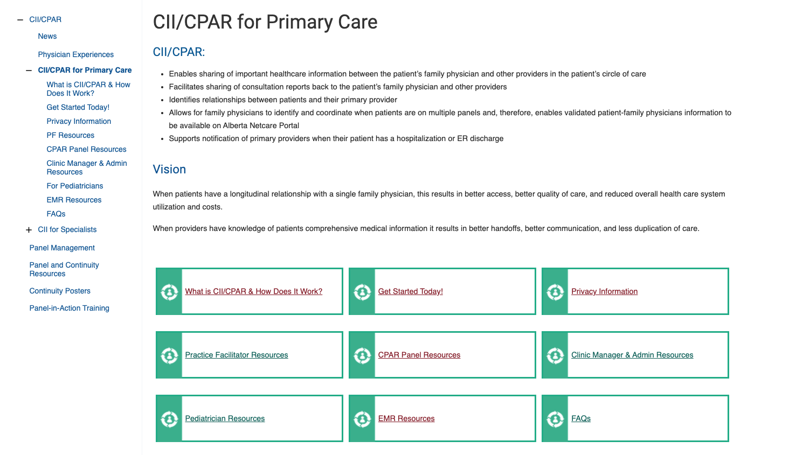
Web Page – CII/CPAR for Primary Care
https://actt.albertadoctors.org/cii-cpar/toolsresources
Key Resources found here:
Privacy Tools
  PIA Update Self-Assessment
Clinic Journey Checklist
Panel Readiness Checklist
Team Toolkit
EMR Guides
Participation Forms
Always go to the web page for the most
updated resources
Notes:
All tools referred to in this slide deck may be found on the CII/CPAR Tools and Resources page. https://actt.albertadoctors.org/cii-cpar/toolsresources

Slide 14
How Does CII/CPAR Work?

Slide 15
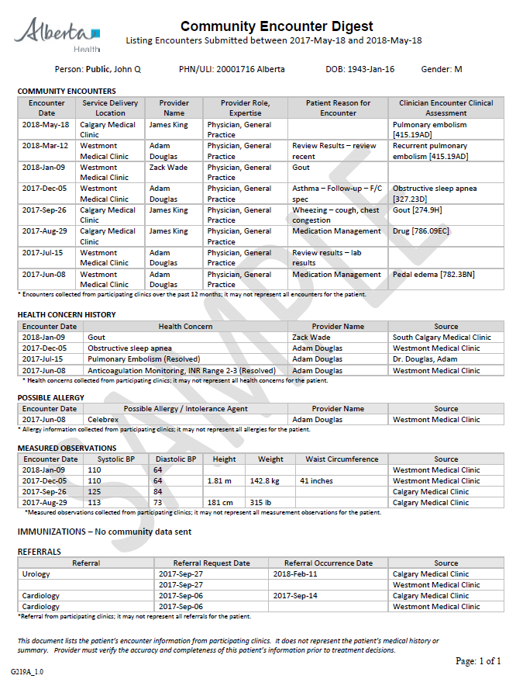



Encounter Data to Community Encounter Digest
CED Report
EMR Encounter Data from defined fields - Automated
Alberta
Netcare
Portal
Community
Physician Office EMR
CII Data
Hub
Health Information
Data Governance Committee
Healthcare
Data
Repository
Example: BP, HT, Wt, WC & Vaccine
Notes:
Key Messages:
Physicians and nurse practitioners need to first register to participate in CII/CPAR.
The first type of patient data shared is encounter data.
EMR encounter data is mapped (defined fields) and uploaded to the CII Data hub and presented in Netcare as a Community Encounter Digest (CED) report and shared with the Healthcare Data Repository to inform program development

Slide 16
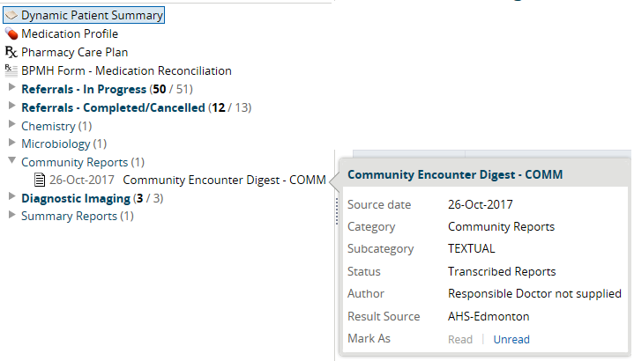
Community Encounter Digest (CED) In Netcare
A new category/folder called “Community Reports” has been added to the Clinical Document Viewer (CDV) tree in Netcare
Notes:
The encounters are rolled up into a 12 month summary called the Community Encounter Digest and these will be displayed in Alberta Netcare in the new “Community Reports” folder.

Slide 17
Community Encounter Digest (CED) Sample
Community Encounters
Encounter Date
Location
Provider Name/Role
Reason for Encounter
Clinical Assessment
Health Concern History
Encounter Date
Health Concern
Provider Name
Source (clinic)
Possible Allergy
Encounter Date
Possible Allergy
Provider Name
Source (clinic)
Measured Observations
Encounter Date
BP, Height, Weight, Waist Circumference
Source (clinic)
Referrals
Type
Request date
Occurrence date
Source (clinic)
Immunizations
Disclosure Message
Notes:
ANIMATED
Key Messages:
For each patient, the Community Encounter Digest (CED) assembles a record of their visits/encounters across all providers participating in CII. It is a rolling snapshot of encounters the patient has had with CII/CPAR enabled clinics over the last 12 months. It is available in Alberta Netcare for other providers in the system to view care the patient has received over the last year and inform care when the patient is in front of them. Only “mapped fields” for which data is entered in a visit flows to the CED in Netcare.
The “Community Encounters” section records the location and reason information for each encounter.
The “Health Concern History” section records any entries made in the problem list during the encounter.
The “Measured Observations” section records any blood pressure, height, weight, and waist circumference values recorded during an encounter.
The “Possible Allergy” section displays any allergy entries made during the encounter.
The “Immunization” section displays immunizations done during the encounter.
The “Referrals” section displays any referrals to specialists done during the encounter.
The disclosure message at the bottom of the CED states:
This document lists the patient’s encounter information from participating clinics. It does not represent the patient’s medical history or summary. Provider must verify the accuracy and completeness of this patient’s information prior to treatment decisions.
See a sample CED here: https://actt.albertadoctors.org/file/CII_CED_Sample.pdf

Slide 18
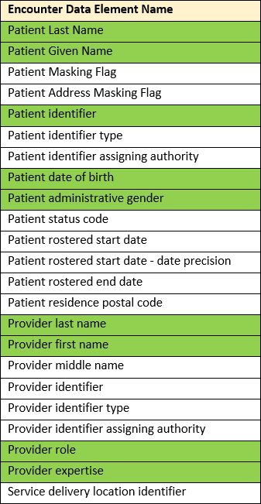
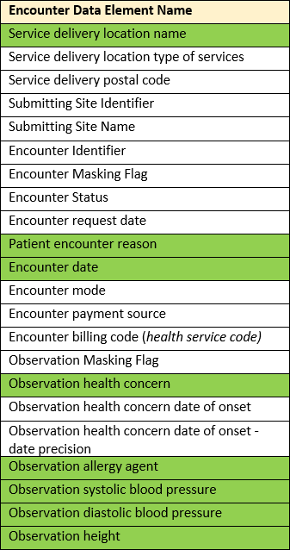
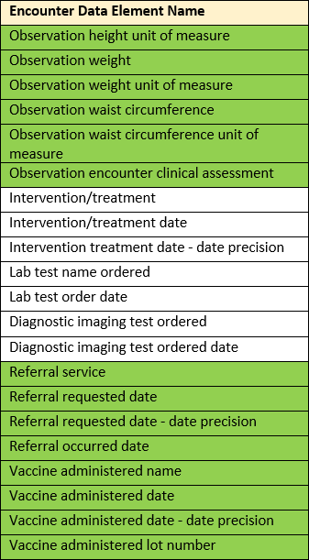
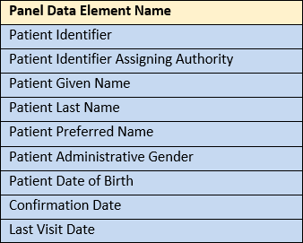
CII Data Elements CPAR
Encounter Data Element Legend:
Netcare – indicates data elements
published in the current CII Community Encounter Digest (CED) report and uploaded to Healthcare Data Repository
Indicates data elements uploaded to Healthcare Data Repository
CPAR – indicates data elements
uploaded to CPAR and Data Repository
Notes:
This shows the exact data elements that are uploaded to Netcare, the Healthcare Data Repository and the Central Patient Attachment Registry. These elements were recommended by CIHI, the Canadian Institute for Health Information, as standard data that should be part of a shared health record.

Slide 19
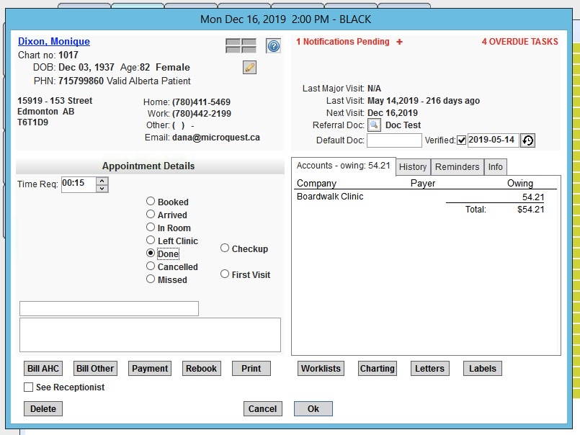
Conditions that allow for Encounter information to flow to the CED in Netcare
Healthquest determines if a chart item is valid to submit to CII if ALL the following criteria are met:
The provider attached to the chart note is live on CII
The patient has an appointment and valid demographics.
The patient is NOT marked as confidential and the chart is NOT marked as Physicians Only.
The chart note is NOT marked as confidential
The appointment is marked as Done
Notes:
Although no steps need to be completed for this data submission to take place, it is important that users understand the conditions that will allow appointments to be sent to Alberta Netcare:
The provider attached to the visit is live on CII
The patient has an appointment and valid demographics
The patient’s chart is not marked as confidential or Physician only
The chart note is not marked as confidential
The provider signs off and closes the visit note by choosing Sign-off visit and Close Chart or by choosing Save on previously signed-off visits.
There are also some conditions explaining the role of the primary provider (as custodian of the record) and the specialist when they are on the same instance of Healthquest. This would occur in a clinic group with one instance of Healthquest. An explanation of which information flows is in this document:
https://actt.albertadoctors.org/file/CII-CPAR_Considerations_for_Partially_Onboarded_Clinics.pdf
It becomes important when a specialist wants to participate in CII but the EMR also has family practices using it where the primary provider may not yet be participating in CII/CPAR.

Slide 20
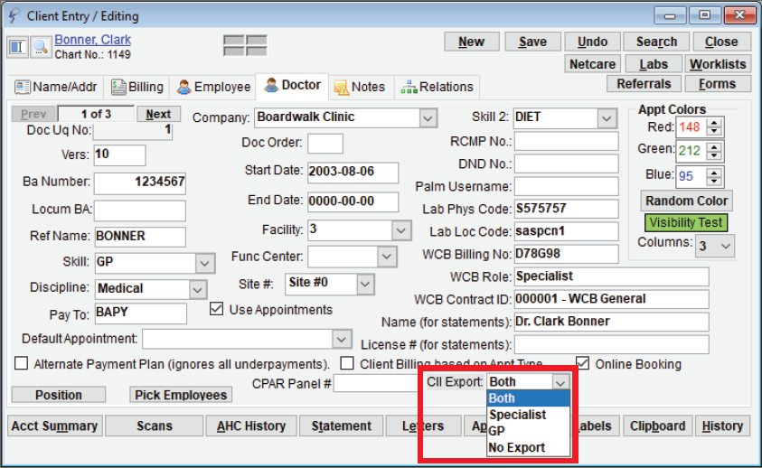
Encounters- EMR Checklist Before Go-Live
For Providers Submitting Encounters:
Register for CII with eHealth Support Services
Configure the Doctor Card
  Open the practitioner’s Client Card
  Select the Doctor tab
  Select the appropriate option from the CII Export menu to send encounter information to Netcare:
  Both: both Encounter Data and Consult Reports are sent to Alberta Netcare
  Specialist: for specialists who wish to submit only consult reports
  GP: for providers with panels who only want to send encounter information to Netcare.
  No Export: for specialists who would not like any information sent to Alberta Netcare
Determine which EMR fields map to the CED
Understand how to prevent encounter data from sending
Notes:
This slide outlines the steps that must be completed to enable a provider to share encounter data with Alberta Netcare.
A provider must enroll for CII with eHealth Support Services. For more information about the registration process, see either of the following ACTT webpages:
Get Started Today for Specialists webpage: https://actt.albertadoctors.org/CII-CPAR/CII-for-Specialists/Pages/Get-Started-Today.aspx, or the
Get Started Today for Primary Care webpage: https://actt.albertadoctors.org/CII-CPAR/cii-cpar-primary-care/Pages/Get-Started-Today.aspx
Once the CII/CPAR participation paperwork has been completed, doctors and allied health professionals who wish to submit data must configure their doctor cards to allow for flow of data.
This need only be done once, per participating provider.
The field is editable should submission type(s) change over time.
Select:
Both - for specialists who wish to submit consult reports and encounter information to the Community Encounter Digest (see the “Sharing Encounter Data to Alberta Netcare Portal” section of this slide deck for more information on how specialists can choose to share encounter data).
Specialist - for specialists who wish to submit only consult reports
GP: for providers with panels who only want to send encounter information to Netcare.
No Export – for specialists who would not like any information sent to Alberta Netcare
Note: for any future practitioner added to Healthquest, you must properly set the CII Export to ensure their selected data is sent to Netcare.
Each clinic will be asked to meet with a Healthquest consultant to determine which EMR fields map to the CED. To review the EMR mapping, refer to the Healthquest CII/CPAR EMR user guide on the ACTT website: https://actt.albertadoctors.org/file/Microquest_Healthquest_CII-CPAR_Guide.pdf
Review the processes for keeping patient data confidential in the Healthquest CII/CPAR EMR user guide: https://actt.albertadoctors.org/file/Microquest_Healthquest_CII-CPAR_Guide.pdf.

Slide 21
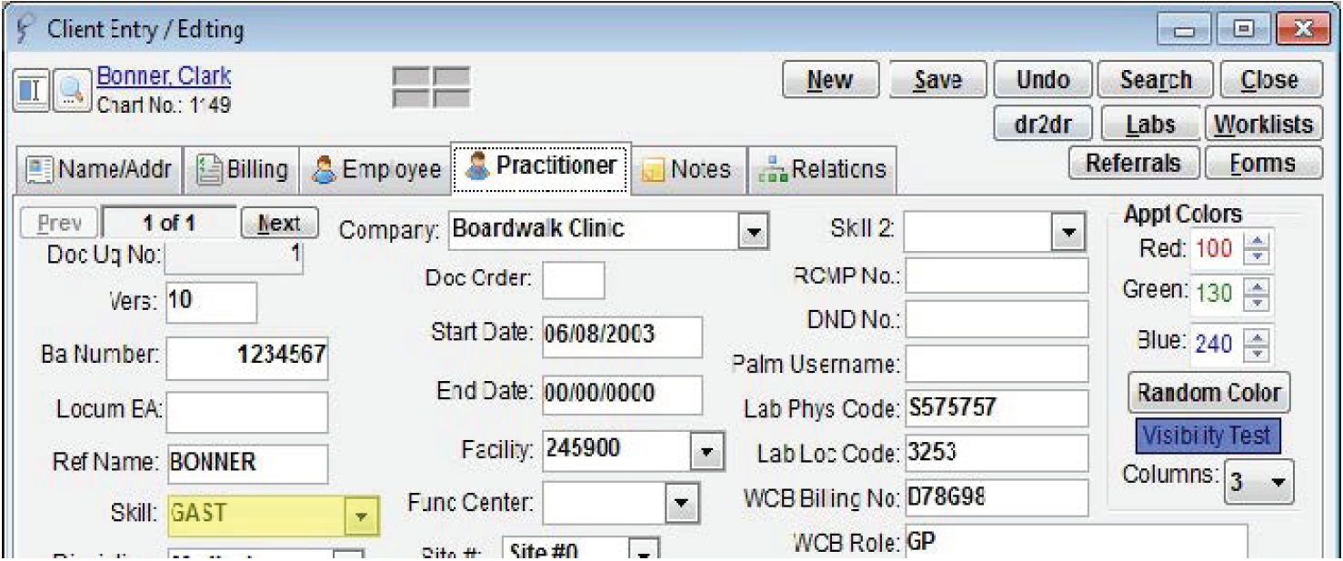
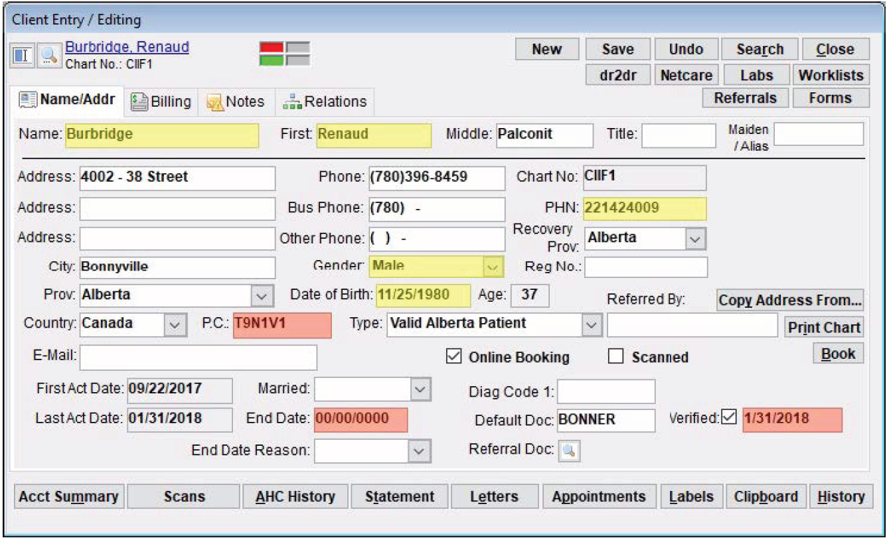
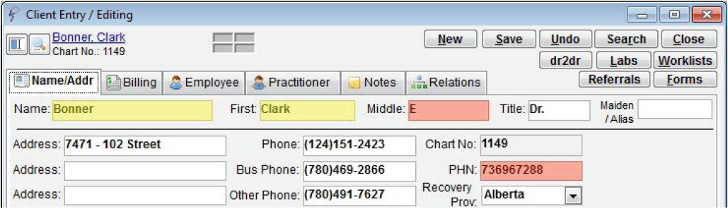
Healthquest Data Mapping
Data that Maps to Alberta Netcare CED and the Healthcare Data Repository
Patient Demographics
Name
PHN
Gender
Date of Birth
Provider Details

Slide 22
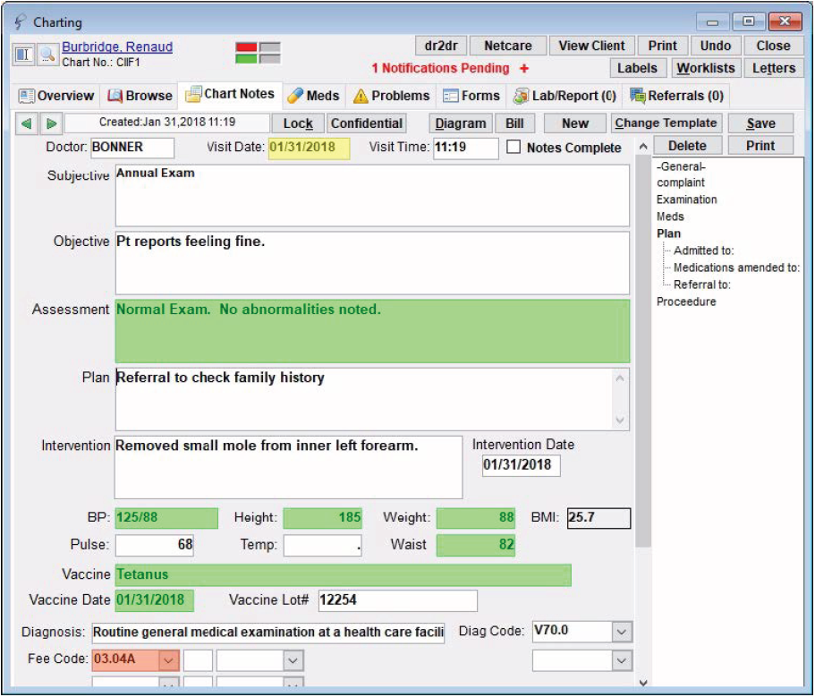
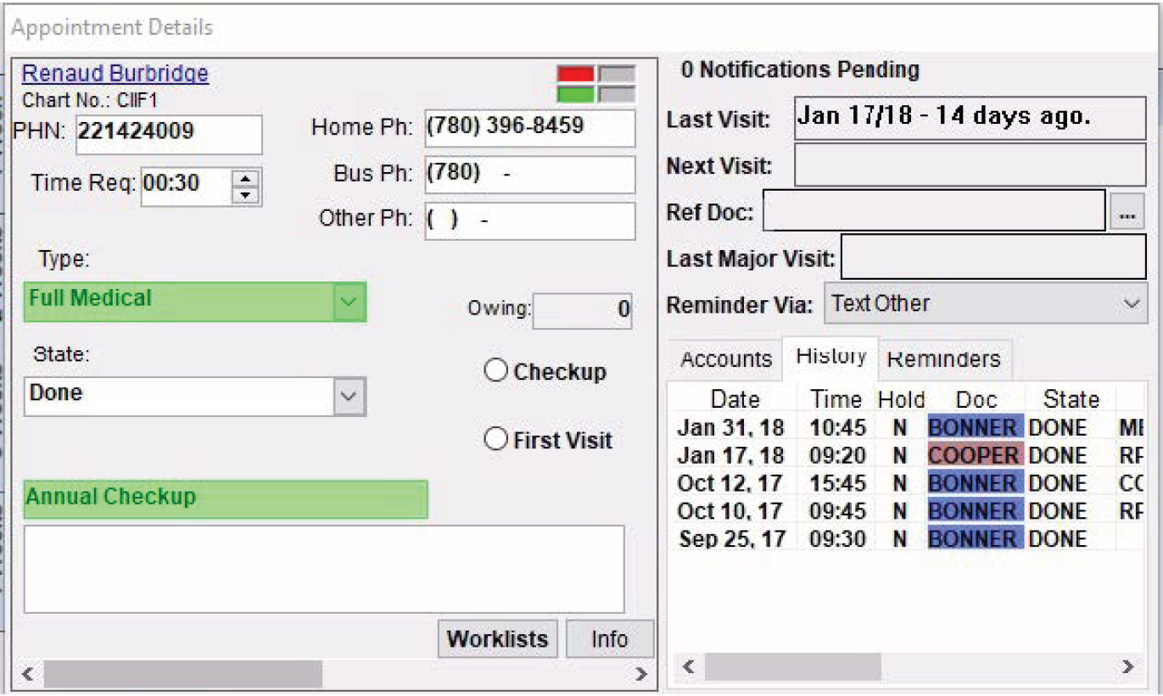
Healthquest Data Mapping
Data that Maps to Alberta Netcare CED and the Healthcare Data Repository
Reason for Visit
Assessment
Observations
BP
Height
Weight
Waist
Diagnosis
*Participating clinics may choose to submit the ‘Type’ and/or the short note line as the Reason For Visit
Notes:
There is room for some customizability for Healthquest users. One option is in the “Reason for Visit”. It can map from the ‘Type’ and/or the short note line depending on how the clinic is using these field.
Healthquest will go over the Chart Notes on a per physician basis and configure for where the physician is documenting the assessment. Physicians can choose.
Some clinics create a ‘CII chart note template’ and document in that template when they want information to submit to the Community Encounter Digest. Some clinics choose to add a ‘CII notes’ field to existing templates and then the provider chooses to add to that note box to submit to CII.
The observation fields are customized to the chart notes the provider indicates they want to be mapped from.

Slide 23
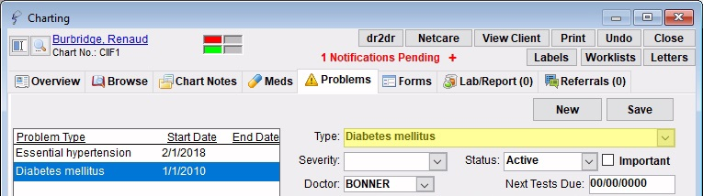
Healthquest Data Mapping
Data that Maps to Alberta Netcare CED and the Healthcare Data Repository
Problems

Slide 24
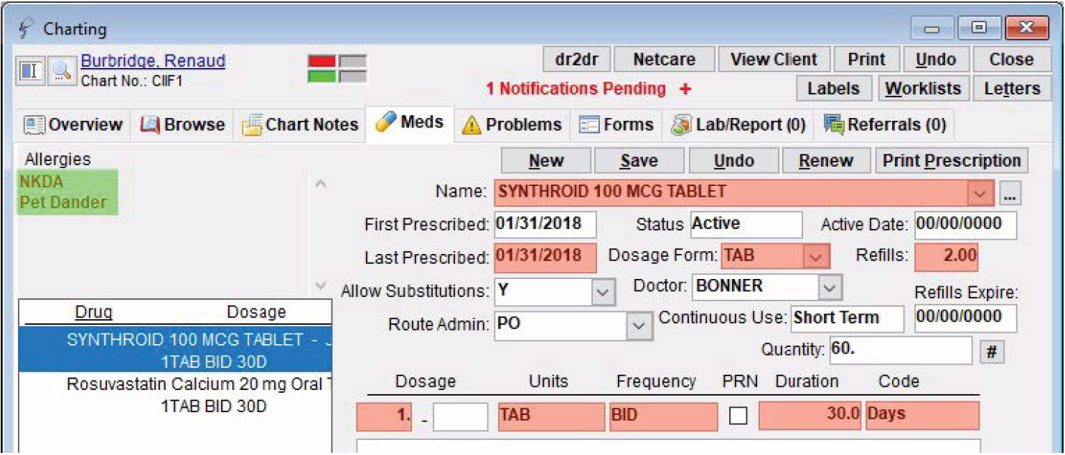
Healthquest Data Mapping
Data that Maps to Alberta Netcare CED and the Healthcare Data Repository
Medications and Allergies

Slide 25
Healthquest Data Mapping
Data that Maps to Alberta Netcare CED and the Healthcare Data Repository
Immunizations

Slide 26
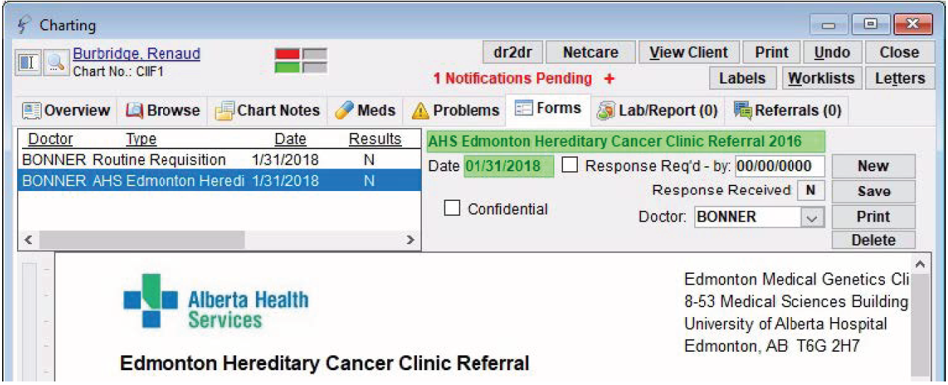
Healthquest Data Mapping
Data that Maps to Alberta Netcare CED and the Healthcare Data Repository
Referrals

Slide 27
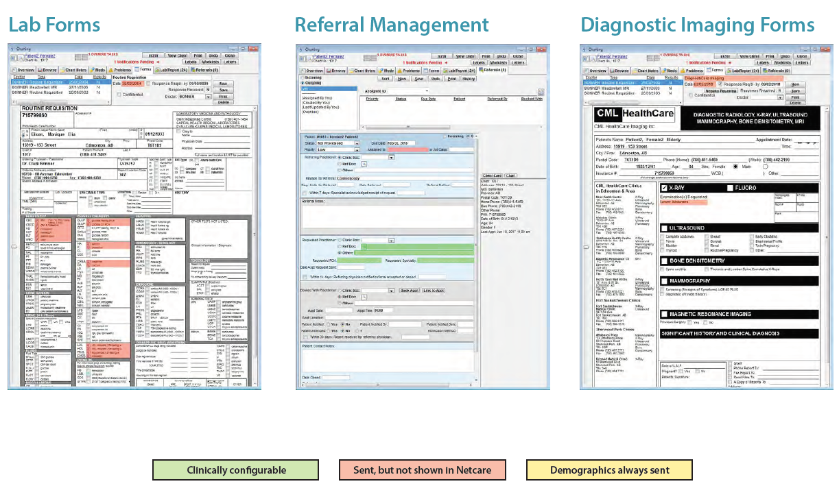
Data that Maps to the Healthcare Data Repository
Lab Forms
Referral Management
Diagnostic Imaging Forms

Slide 28
Microquest Offers Customized Data Mapping
How it works:
Site submits Confirmation of Participation (CoP) form to eHealth Support Services
Registration is initiated at eHealth
  Site submits PIA endorsement letter as part of participation package
  eHealth Support Services team requests Microquest Healthquest schedule a data mapping session with clinic
  Microquest contacts site and reviews Healthquest charting practices and conducts the data mapping
Notes:
Healthquest users have quite a bit of customizability with Microquest to map certain field to the CED. Once Microquest receives the request from eHSS, they will do an assessment of the documentation practices before conducting the mapping session with each provider in the clinic who has enrolled.

Slide 29
Healthquest Fields to the CED
Notes:
Janet
Key Messages:
This slide is a good summary of the specific fields in Healthquest where information is shared to the CED in Alberta Netcare. (UP TO JANET IF ANIMTED NOTES WITH CLICKS BELOW ARE USEFUL)
**ANIMATED**
**CLICK** The patient’s demographic information at the top of the CED pulls from the patient’s Client Entry screen in the EMR.
In the “Community Encounters” Section:
**CLICK** The provider name pulls from the Provider’s Client Entry screen in the EMR.
**CLICK** The patient reason for encounter pulls from the Type field in the Appointment Details section of the EMR.
**CLICK** The clinician encounter clinical assessment pulls from the Assessment field in the Chart Notes tab.
**CLICK** The “Health Concern History” section pulls the health concern from the Type field in the Problems tab.
**CLICK** The “Possible Allergy” section pulls from the Allergies field in the Meds tab.
**CLICK** The “Measured Observations” section pulls from the BP, Height, Weight, and Waist fields in the Chart Notes tab.
**CLICK** The “Immunization” section pulls from the Vaccine and Vaccine Date fields in the Chart Notes tab.
**CLICK** The “Referrals” section pulls from the Forms tab.
If a field is not highlighted, then information from that field does NOT leave the EMR
Note that information only pulls from go-live day moving forward and anything entered in the notes will not pull.
As I mentioned earlier, each clinic will have a short meeting with HQ to do the data mapping as seen above. My meeting was less than 10 minutes, and I then took back the information to the rest of my team (list who….)
Sheena
Thanks for explaining how physicians and multi disciplinary team members can share select patient encounters to enhance the limited community information that exists in Netcare today. There is also an option to share community consult reports.
Chris, can you tell us more about this?

Slide 30
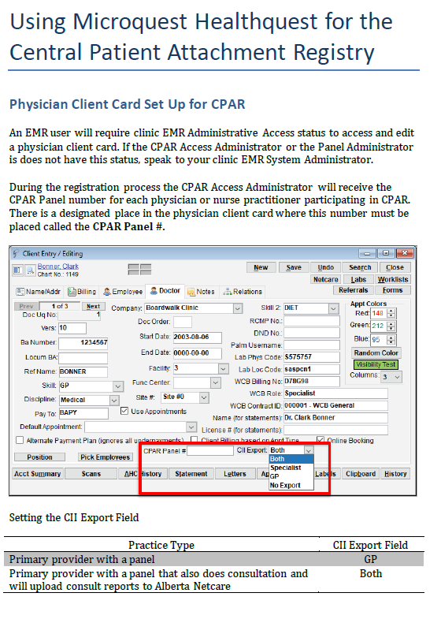
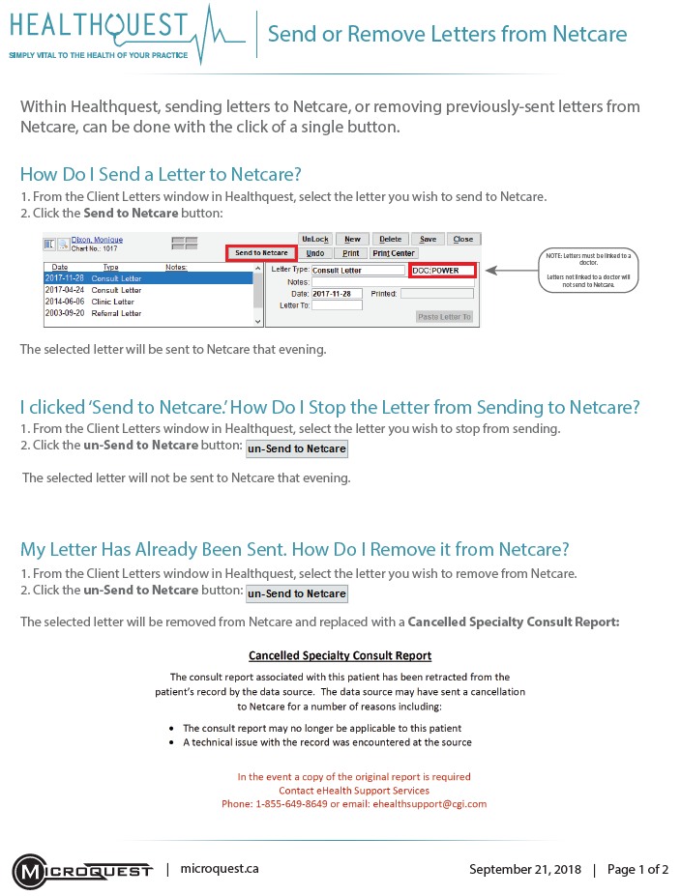
Refer to the Healthquest EMR CII and CPAR Guides
https://actt.albertadoctors.org/cii-cpar/toolsresources
See the EMR Guides and Mapping section

Slide 31
Keeping Records Confidential – Do Not Share Encounters
You can prevent selected health information from being sent to the Alberta Netcare Portal by making patient data private or confidential:
Do not document confidential information in a mapped field
Make an entire patient’s chart confidential by marking the client as confidential or marking the chart as physicians only (no information will be sent to Netcare).
Make a chart note confidential (observation details in that encounter will not be sent to Netcare).
Healthquest has several options for masking confidential patient information. Any information marked as confidential in Healthquest will also be marked as confidential in Netcare and will not be included in the CED report.
Notes:
If a patient requests that all or part of their health information remain confidential, you can prevent selected health information from being sent by “masking” the data (making the data private or confidential).
You can mask:
An entire patient’s chart (mark the patient as confidential or mark the patient’s chart as Physicians only) – no information will be sent to Alberta Netcare.
A chart note (observation details in the patient encounter will be masked) – no information from that chart note will be sent to Alberta Netcare

Slide 32
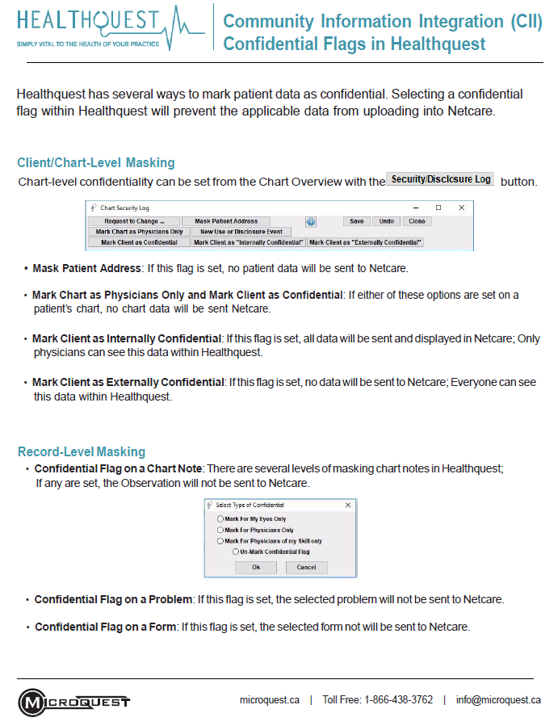
Keeping Records Confidential – Do Not Share Encounters
See the CII Confidential Flags in Healthquest guide on the CII/CPAR tools and resources page:
https://actt.albertadoctors.org/CII-CPAR/cii-cpar-primary-care/Pages/EMR-Resources-Primary-Care.aspx
to learn more about the confidentiality features in Healthquest EMR to mark a chart as confidential and not share the information with the CED in Alberta Netcare
Notes:
Providers should know that there are features in Healthquest EMR to keep the information in the clinic from displaying in Netcare.

Slide 33
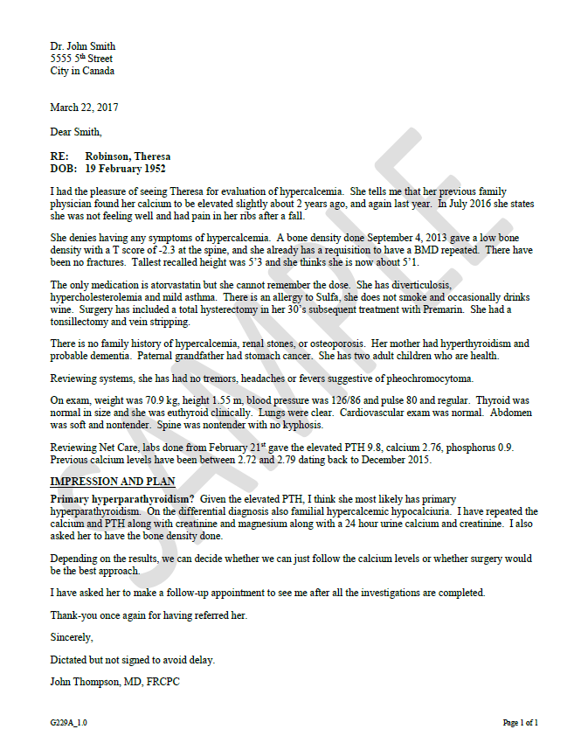
Consult Reports in Netcare
Consult Report
Consult Report
Community
Physician Office
EMRs
CII Data
Hub
Alberta Netcare Portal
Notes:
Key Messages:
The same patient consult report .pdf file that is sent to the referring provider can also be shared to Alberta Netcare
The specialty provider has the ability to choose which reports to upload, and which not to
The information is uploaded through the CII Data Hub and displayed in Netcare as a .pdf
Note: This information does not flow to the Healthcare Data Repository

Slide 34
Consult Reports - EMR Checklist Before Go-Live
For Providers Submitting Consult Reports:
Register for CII with eHealth Support Services
Configure the Doctor Card
  Open the practitioner’s Client Card
  Select the Doctor tab
  Select the appropriate option from the CII Export menu:
  Both: both Encounter Data and Consult Reports are sent to Alberta Netcare
  Specialist: only Consult Reports are sent to Alberta Netcare
Notes:
This slide outlines the steps that must be completed to enable a provider to share consult reports with Alberta Netcare.
A provider must enroll for CII with eHealth Support Services. For more information about the registration process, see either of the following ACTT webpages:
Get Started Today for Specialists webpage: https://actt.albertadoctors.org/CII-CPAR/CII-for-Specialists/Pages/Get-Started-Today.aspx, or the
Get Started Today for Primary Care webpage: https://actt.albertadoctors.org/CII-CPAR/cii-cpar-primary-care/Pages/Get-Started-Today.aspx
Once the CII participation paperwork has been completed, doctors and allied health professionals who wish to submit data must configure their doctor cards to allow for flow of data.
This need only be done once, per participating provider.
The field is editable should submission type(s) change over time.
Select:
Both - for specialists who wish to submit consult reports and encounter information to the Community Encounter Digest (see the “Sharing Encounter Data to Alberta Netcare Portal” section of this slide deck for more information on how specialists can choose to share encounter data).
Specialist - for specialists who wish to submit only consult reports
GP: for providers with panels who only want to send encounter information to Netcare.
No Export – for specialists who would not like any information sent to Alberta Netcare
Note: for any future practitioner added to Healthquest, you must properly set the CII Export to ensure their selected data is sent to Netcare.
More detailed instructions can be found in the Healthquest CII/CPAR EMR user guide on the ACTT website: https://actt.albertadoctors.org/file/Microquest_Healthquest_CII-CPAR_Guide.pdf

Slide 35
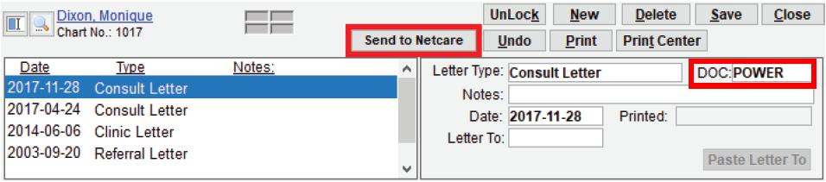
Sending Consult Reports to Netcare
Once configuration steps have been completed and the clinic is enabled:
From the Client Letters window in Healthquest, select the letter you wish to send to Netcare.
Click the Send to Netcare button.
The letter will be sent to Netcare that evening.
Letters must be linked to a doctor.
Letters not linked to a doctor will not send to Netcare.
Notes:
Registration in CII followed by EMR configuration in Healthquest allows for consult reports to be sent to Alberta Netcare.
To send a consult report to Alberta Netcare after your CII go-live day:
From the Client Letters window in Healthquest, select the letter you wish to send to Alberta Netcare.
Click the Send to Netcare button. The consult letter is sent to Alberta Netcare as a PDF consult report.
Note: when you click the Send to Netcare button, the consult report is automatically sent to Alberta Netcare that evening***
***You will, however, still be required to follow the CPSA standard of practice for referral consultation. See clause 10b of the CPSA’s Referral Consultation standard of practice for more details: https://cpsa.ca/wp-content/uploads/2020/05/Referral-Consultation.pdf“. The benefit of sharing your consult report to Alberta Netcare is that it is now available to all health care providers, without the need to ‘refax’ or mail additional copies and signals to other providers that you are managing that given condition.

Slide 36
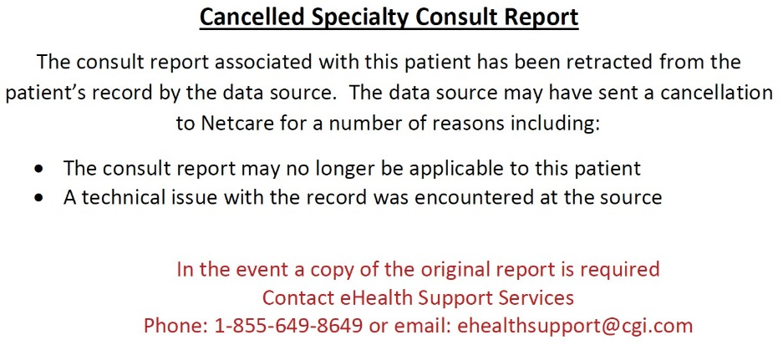
Unsending Consult Reports to Netcare
I clicked ‘Send to Netcare.’ How Do I Stop the Report from Sending to Netcare?
From the Client Letters window in Healthquest, select the report you wish to stop from sending.
Click the button.
The selected report will not be sent to Netcare that evening.
My Report Has Already Been Sent. How Do I Remove it from Netcare?
From the Client Letters window in Healthquest, select the report you wish to remove from Netcare.
Click the button.
The selected report will be removed from Netcare and replaced with a Cancelled Specialty Consult Report.
This is what the Cancelled Specialty Consult Report looks like in Netcare
Notes:
If you submit a consult report to Alberta Netcare in error, clicking the un-Send to Netcare button will stop the report from sending to Alberta Netcare that evening or remove the report from Alberta Netcare and replace it with a Cancelled Specialty Consult Report the following day.

Slide 37
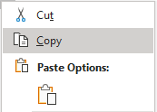
Attaching Results to Your Consult Reports
Healthquest does not have the ability to add an attachment to the consult report.
Content from other areas of the chart can be added to the consult report using copy and paste.
Notes:
Healthquest does not have the ability to attach investigations or results from the EMR. The letter is fully editable though, meaning that anything that can be cut and pasted can be included.
Some clinics run optical character recognition on all files before they’re imported into the EMR so that the text can then be cut and pasted within the EMR.

Slide 38
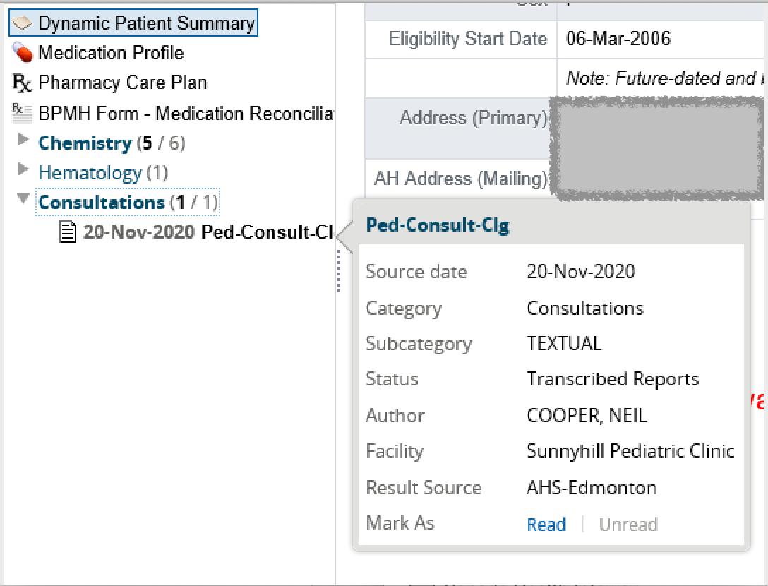
Consult Reports in Netcare
Standard notation is:
Specialty (as per skill code in EMR)
Consult
City/town
Other providers can see, at a glance, that this patient has a Peds Consult
Tool tip displays
Source date, category, sub-category, status, author, result source and facility
Notes:
Key Messages:
Uploaded specialist consult reports will appear in a new section in the Netcare menu “Consultations”.
Reports uploaded will appear with the date and type of consult.
Hovering over the item in the list will pop up a tool tip box with additional information
Note: Results Source for all content through CII, which goes through Netcare, indicates “AHS-Edmonton”

Slide 39

CPAR
Uploads and Reports
CPAR panel conflict reports available by the 2nd of the month
* Upload error reports available next day. Demographic mismatch reports available 2 days after upload.
Healthquest users panels will submit automatically on the 8th of the month *
1
2
8
10
Optional: Healthquest users can still use the manual submit button until the 21st.
CPAR starts to find overlap amongst all submitted panels. No uploads between the 22nd and last day of the month.
21
22
Notes:
Brief Point:
- There is a schedule for the automatic uploads of panels to CPAR.
Key Message
-Microquest loads Healthquest panels on the 8th
-TELUS uploads panels automatically on the 10th of the month.
-QHR Uploads automatically on the 12th of the month.
Healthquest and Accuro uses have a manual function to resubmit panels in the EMR until the 21st of the month. This is optional.
Panel conflict reports are available by the 2nd of the next month (earlier in the “young” days of CPAR).
If a clinic looks at their panel and notices that they made changes and want TELUS or QHR to re-upload the panel manually, they need to contact TELUS or QHR.
A new uploaded panel always replaces an old panel in CPAR.

Slide 40
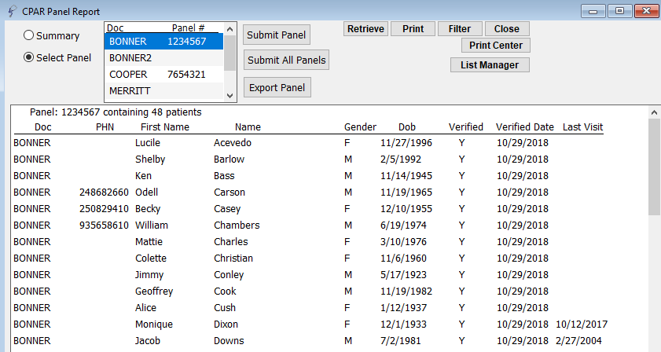
Microquest will Automatically Upload on the 8th
Optional: How to Manually Upload a Panel to CPAR
In Reports > Client Lists > CPAR Reporting
2. Select Provider
3. Click Retrieve
4. Review Panel List
(Options to Export or Print)
1. Select Panel
5. Click Submit Panel
(Option to Submit All Panels of all participating family physicians or nurse practitioners with one click)
Notes:
Microquest will automatically upload your panel on the 8th of the month. You can use this feature to run the list before the upload and view the patients that are submitting to CPAR.
If a clinic makes a significant change in their panel and wants to re-upload the panel, complete the process above by the 21st of the month.

Slide 41
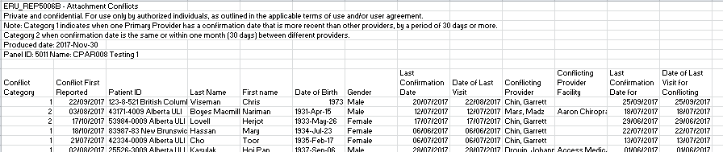
Reports Available for Download
1. Conflict report
Identifies patients paneled to more than one provider
Compares dates of confirmation and dates of last visit for the providers the patient is paneled to
Notes:
The two reports a PA will receive from CPAR include the Conflict Report which shows attachment conflicts between the primary provider and any other providers that the patient has been paneled to and confirmed. It identifies last visit date and confirmation dates for both/all providers and it identifies the conflicting provider and facility.

Slide 42
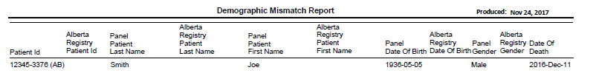
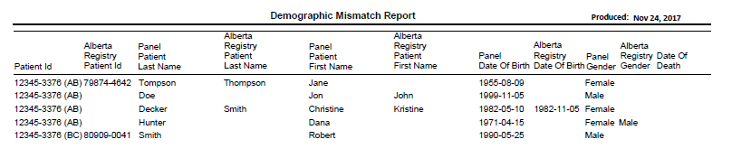
Reports Available for Download
2. Demographic Mismatch Report
Identifies deceased patients
Patients where demographic data is different from the Provincial Client Registry
Notes:
The two reports a PA will receive from CPAR include the Conflict Report which shows attachment conflicts between the primary provider and any other providers that the patient has been paneled to and confirmed. It identifies last visit date and confirmation dates for both/all providers and it identifies the conflicting provider and facility.

Slide 43

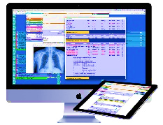

CII/CPAR Overview Future State
Community Physician Offices
Provincial IT Systems
* Clinical Encounter Digests
* Specialist Consult Reports
Patient Summary Reports
Display CPAR Primary Provider In Netcare
Patient Data
Uploaded
to Hub
Patient Data/Reports
Uploaded to Provincial
IT Systems
CII Data
Hub
* Clinic Encounters
* Patient Panels
* Specialist Consult Reports
* Patient Summary Reports
Alberta Netcare
* Patient Panel Data
Notifications
Downloaded
to Clinic EMRs
Central Patient
Attachment Registry
Patient
Summary
Uploaded
to MyHealth
Panel Data Extracted
* E-Notifications
Hospital Admit/Discharge
Emergency Department Visits
Day Surgery
* Clinical Encounter Data
* Patient Panel Data
* Patient
Summary
Reports
Healthcare Data
Repository
MyHealth Records
Notes:
Key Messages:
New functionality will be added to CII/CPAR in the near future
In the planning stages is the Patient Summary Report. Physicians will have the opportunity, within their EMR, to curate a patient summary that will offer a more complete picture of the patient. These summaries will upload to Alberta Netcare so other providers in the patients circle of care will have more complete information.

Slide 44
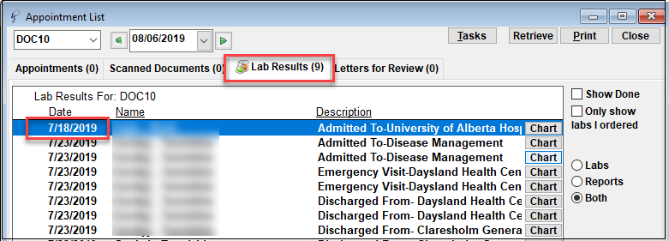
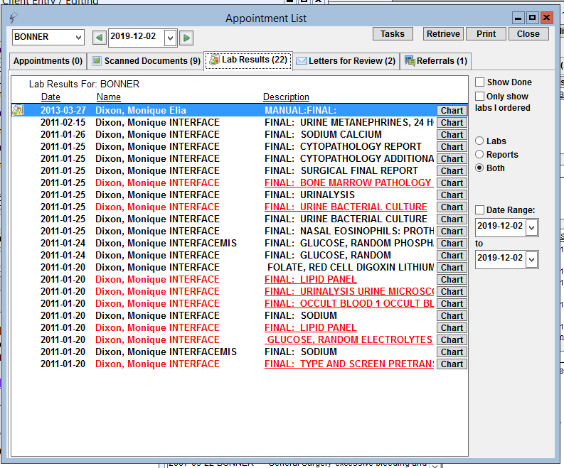
eNotifications
eNotifications appear in the Lab Results tab of a provider’s appointment list
Team members with lab results access can see eNotifications
Information:
  Date
  Patient Name
  Description
  Admission/discharge/ emergency and facility
Team member tip: Use the date filters
https://actt.albertadoctors.org/cii-cpar/toolsresources
Notes:
eNotifications are expected for Wolf in Q1 2020
A notice is received in the provider’s lab report tab and stored in the patient chart
Alerts for an ED visit, hospital admission or discharge or a day surgery
The summary provides additional information
Note: With eNotifications being enabled, there is new information in the Team Toolkit.

Slide 45
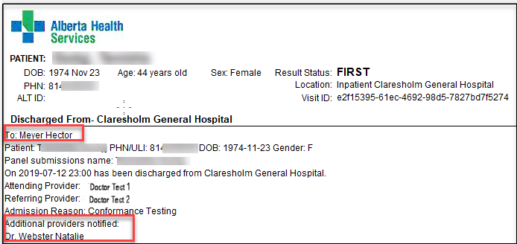
eNotifications
Informs the primary provider when a CPAR-paneled patient has an ED discharge, hospital admission or discharge, or day surgery discharge
Notice is received daily (6 am, 2 pm) in same areas as lab reports and stored in patient chart
Summary provides additional information
Info includes:
Pt demographics
Facility location
Date/time
Attending provider
Admission reason
Additional providers notified
If the patient becomes deceased in ED or hospital, it will indicate (Deceased) or (Deceased, YYYY, MM, DD) beside the patient’s name.
If patient is paneled to more than one provider in CPAR, the eNotification will include “Additional providers notified”.
https://actt.albertadoctors.org/cii-cpar/toolsresources
Notes:
A notice is received in the provider’s lab report tab and stored in the patient chart
Alerts for an ED visit, hospital admission or discharge or a day surgery
The summary provides additional information
Note: With eNotifications being enabled, there is new information in the Team Toolkit.

Slide 46



Benefits of CII/CPAR
PATIENT
PROVIDER
PCN
HEALTH SYSTEM
Better Quality of Care:
Meets patient expectations to have their information readily available to all providers in their circle of care
More coordinated and consistent care
Smoother transitions of care
Less story telling
Less duplication of care
Less time in hospitals
Increased patient safety
Increased satisfaction
Relational Continuity:
Clearer picture of the primary provider’s panel
Ability to deliver better care
Informational Continuity:
Healthcare information available where and when it’s needed
Management Continuity:
Facilitates planning and delivery of more intensive interventions
Time savings:
Patient health care record more complete
Enable PMH Implementation
Panel and Continuity
Care Coordination
Build the Foundation:
Reporting
Quality Improvement
Analytics
Aggregate data for health service planning
More Efficient Care:
Lower healthcare costs
Less utilization
Better Decisions:
Secondary use supports health system planning
More informed program planning
Notes:
There is value in CII/CPAR for Patients, Providers, PCN and the Health System

Slide 47
Participation Readiness

Slide 48


Prerequisites to Participate in CII/CPAR
The clinic must be live on Alberta Netcare Portal
The clinic must have an EMR Privacy Impact Assessment (PIA)
    Support is available to review and make recommendations to bring your PIA up to date, if required
Providers must be panel ready
Using a conformed EMR:
    Microquest Healthquest*
    QHR Accuro*
    TELUS Med Access, PS Suite or Wolf
    *Requires latest version
PIA
Microquest
QHR
TELUS
Notes:
For clinic to participate in CII/CPAR:
Must be enabled on Alberta Netcare
The clinic must have an EMR PIA
Providers with panels must be panel ready
The EMRs that work with CII/CPAR are from Microquest, QHR and Accuro. If using a locally installed version of Accuro or Healthquest, the vendor will work with the clinic to ensure they are using the most recent version.

Slide 49
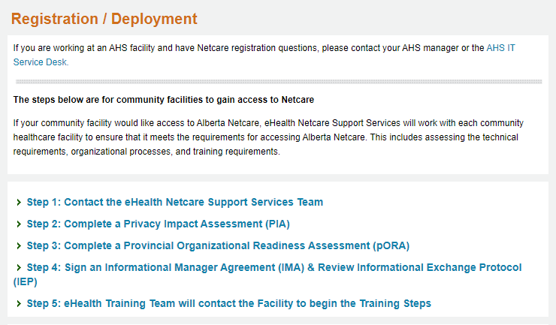

1. Live on Alberta Netcare Portal
The clinic site must be live on Netcare.
If the clinic is not live, please visit the Alberta Netcare website to learn more about registering for Alberta Netcare:
http://www.albertanetcare.ca/Registration.htm

Slide 50
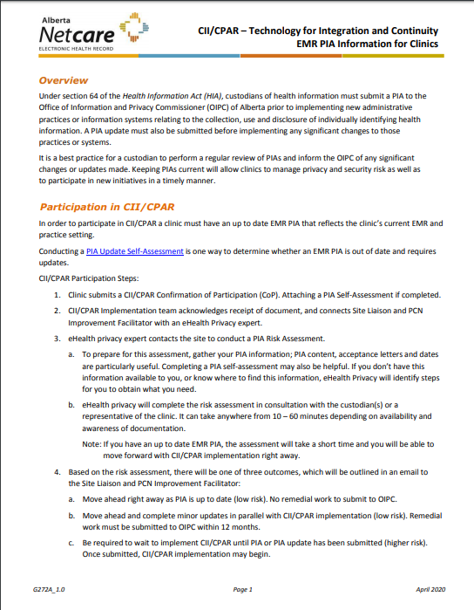
2. Clinic EMR PIA Must be Current
Updated PIA is required, not a NEW PIA
eHealth Support Services assigns an eHealth Privacy consultant to assess the PIA readiness
EMR PIA Information for Clinics
Notes:
This is from the video
Clinics do not need to do a new PIA to participate but if they have not kept it up to date they will need to update it.
It does not need to be updated before they submit the first form the confirmation of participation form.
Once the COP is submitted, eHealth will do an assessment of the clinic PIA.

Slide 51
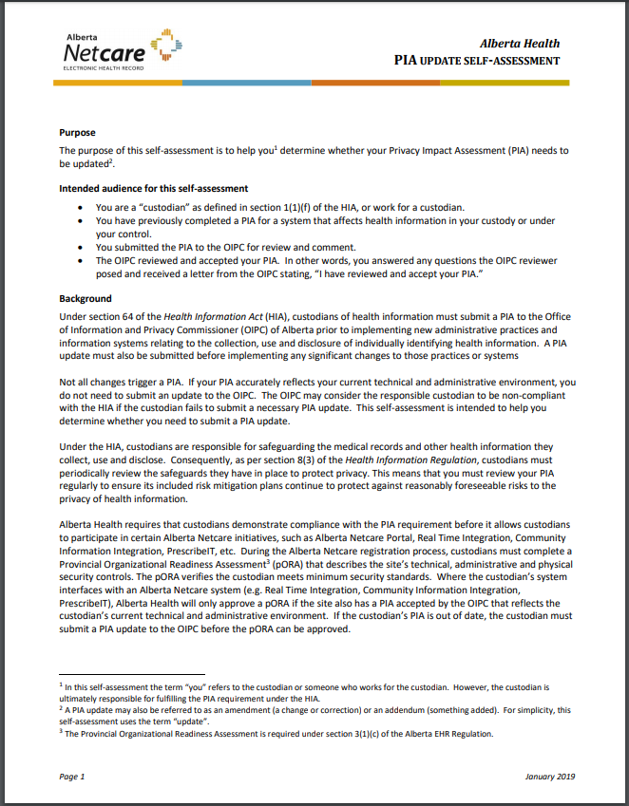
Minor or Major PIA Update?
The PIA Update Self-Assessment will assist in determining if you need to update your PIA.
Potential PIA Updates Triggers: Common Examples
  EMR system change
  EMR change from local to “in the cloud”
  New EMR user access role or group introduced
  Adding EMR access to an organization not in your PIA
  New ways of communicating with patents (e.g., email, text messages)
  Adding wireless access to EMR
  Adding remote access to EMR
  Adding new device access to EMR (e.g., mobile, tablets, laptops)
  Minor change/update
  Update clinic privacy policy and procedures (e.g., 2018 breach reporting requirement)
PIA Update Self-Assessment
Notes:
The PIA Update Self-Assessment will assist the clinic in determining if a minor or major update is ahead for the clinic. This tool is provided as a guide and it is recommended that a member of the clinic complete it at submission of the confirmation of participation (COP) form. Once the CoP form is submitted to Alberta Health eHealth Support Services an eHealth consultant is assigned to the clinic and one of the first activities is that an eHealth privacy consultant will go over this assessment with the clinic. They will provide guidance.
Examples of actions that would likely lead to a major PIA update would be:
EMR system change
EMR change from local to “in the cloud”
New EMR new user access role or group introduced
Adding EMR access to an organization not in your PIA
New ways of communicating with patents (e.g., email, text messages)
Adding wireless access to EMR
Adding remote access to EMR
Adding new device access to EMR (e.g., mobile, tablets, laptops)
See the assessment tool itself for details.

Slide 52
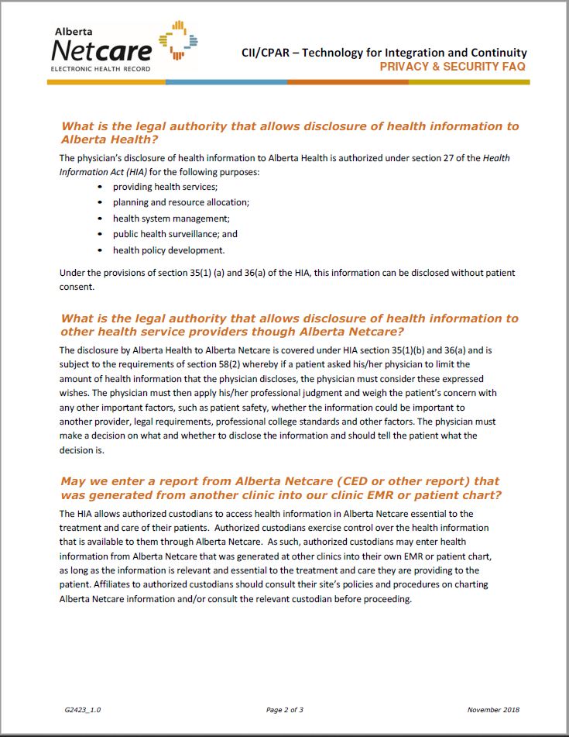
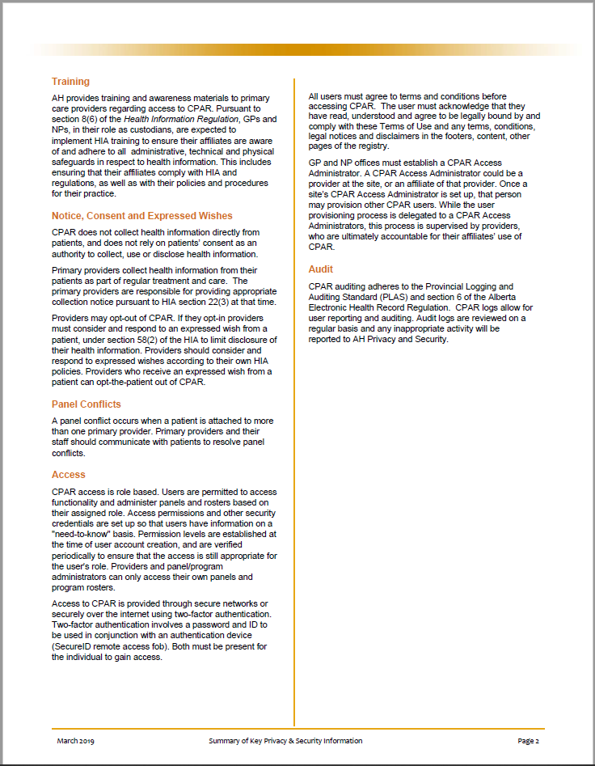
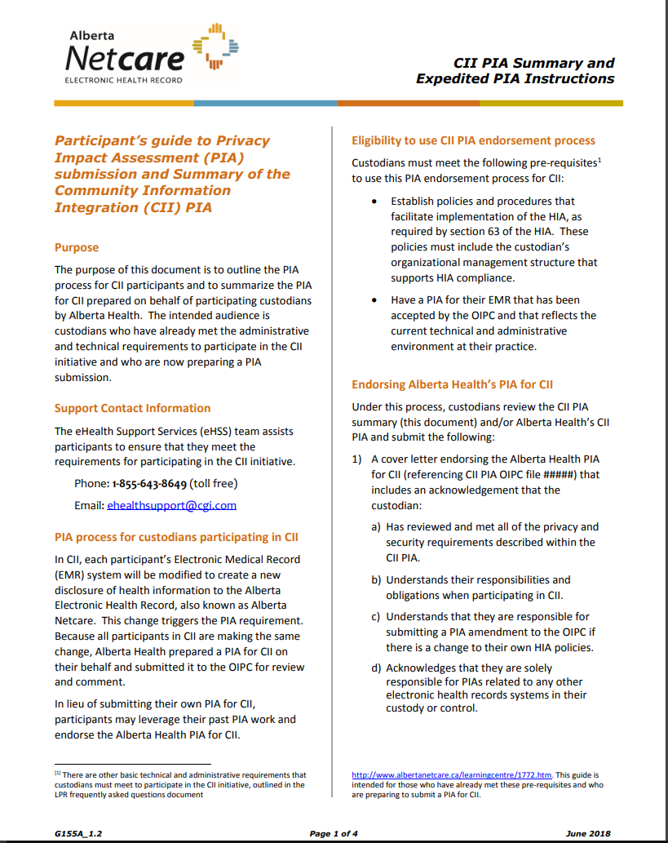
Questions about Privacy?
Privacy Tools
Privacy and Security FAQ
Summary of Key Privacy Info
CII PIA Summary
Notes:
These tools are available on the CII/CPAR Tools and Resources Page: https://actt.albertadoctors.org/cii-cpar/toolsresources

Slide 53
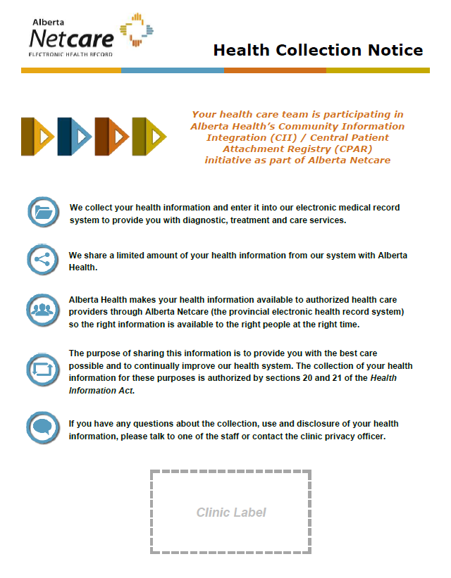







CII/CPAR falls under the Alberta Netcare umbrella, which is covered by the Health Information Act. Providers are not required to
have direct conversations with their patients, however…
About Privacy…
Health Collection Poster
they are obligated to place a Health Collection Notice poster within a patient’s view. A customizable template is provided to the clinic.
Patient Brochure
If patients have further questions, CII Patient Brochures are also provided.
?
Custodian & Clinic Script
A Custodian and Clinic Script for Patients is provided which outlines how to discuss patient’s expressed wishes and the use of confidential flags.
Patient FAQ
The Patient Frequently Asked Question (FAQ) document explains the CII/CPAR initiative and its implications to patients of CII/CPAR clinics. It also provides patients with contact details* if they have more questions.
Privacy & Security FAQ
The CII/CPAR Privacy & Security FAQ further details
the sharing of health information.
Health
Collection
Poster
* eHealth Netcare Support Services at 1-855-643-8649 or ehealthsupport@cgi.com
Notes:
Participants in CII/CPAR will have a health collection poster to post in their clinic. Use the new poster to replace the existing Netcare poster. A provider/clinic is not obligated to inform each patient, beyond posting the Health Collection Notice.
If patients have questions there is a brochure.
If a patient has questions beyond the brochure, there is a team script.
If the patient still has more questions there is an FAQ with a 1-800 number.
In the end, the patient has two options. The patient can have their information flagged as confidential at the clinic or they have the option of having their record masked in Alberta Netcare. Few Albertans have chosen to have their record masked in Alberta Netcare.
The Health Collection Notice poster may be downloaded from the CII/CPAR Tools and resources page: https://actt.albertadoctors.org/PMH/panel-continuity/CII-CPAR/Pages/Tools-and-Resources.aspx See other languages available.
Physician offices may take the poster as a template and customize it to their clinic.
There is an obligation under the Health Information Act to notify patients about collection of health information. If a provider wants to include it on a registration form instead of a poster, they are able to have flexibility with HOW patient notice is given.

Slide 54



Privacy: Patient Tools
CII Patient Brochure
Custodian and Team Script
Patient FAQ
Notes:
These tools are available on the CII/CPAR Tools and Resources Page: https://actt.albertadoctors.org/cii-cpar/toolsresources

Slide 55


3. Panel Ready* – Panel Readiness Checklist
All boxes must be checked off on the panel readiness checklist
*Panel readiness does not apply to providers that will participate and submit encounters and/or consult reports but no panels.
Notes:
Clinics that participate in CPAR must be panel ready, in other words, have established processes in place to identify and maintain their panels.
These tools are available on the CII/CPAR Tools and Resources Page: https://actt.albertadoctors.org/cii-cpar/toolsresources

Slide 56
What Must Physicians Do?
What is Optional?

Slide 57





CII/CPAR Physician Experience – Pre Go-Live
Physician(s) Required Activities
Physician Optional Activities
Clinic identifies team member to be Site Liaison (usually clinic manager)
Receive information about CII/CPAR including mapping in the EMR
Decide to participate in CII/CPAR
PIA
Meet with clinic manager/ privacy officer about PIA
Sign participation forms and AH PIA endorsement letter
Meet with PCN facilitator
Notes:
All participating physicians must review the CPAR information and mapping in the EMR (this presentation).
Once a decision has been made to participate, forms must be signed including the AH PIA endorsement letter.
Activities that may involve a physician, but do not have to, include:
Identify a clinic site liaison
PIA update work may involve the clinic privacy officer or a physician custodian at the clinic
One or more physicians may choose to meet with the PCN facilitator about CII/CPAR

Slide 58




CII/CPAR Physician Experience – Post Go-Live
Physician(s) Required Activities
Physician Optional Activities
Provider or delegate views CEDs in Netcare for quality assurance
CII
CPAR
Go Live
Review panel conflict report and give feedback
Optional evaluation
Receive eNotifications when CPAR patients are in hospital or ER; advise on team process
Provider may participate in quality improvement meetings
Notes:
After go live a physician must:
Review their monthly panel conflict report and give direction to the team on priorities
Receive eNotifications (when enabled and signed up for) for CPAR paneled patients that have had a hospital admission or discharge, ED visit or day surgery. The clinic team should establish team workflow for these notifications at the direction of the primary provider
At go-live and periodically thereafter, a provider or delegate view the CEDs in Netcare as feedback on clinic documentation and presentation in the CED. A behaviour that can support this is activity is to view the CED of frequent clinic visitors after go live
It is optional for physicians to complete the CII/CPAR Evaluation
Physicians may participate in team QI meetings; these may be led by one clinic physician, depending on the QI model at the clinic

Slide 59
Ready to Participate?

Slide 60

The Clinic Journey
Registration and Participation: For Clinics with Panels
Notes:
This is the process for clinics with panels.
Registering for CII/CPAR is a lot like registering for Netcare. For clinics that will be submitting panels and encounters, there are 5 forms to be completed. Approximate processing times are on the slide.
The time it takes for sites to obtain signatures and submit forms to eHealth is not included in the estimated times
Each form includes an instructions page to assist with completion. The electronic forms MUST be completed on computer, not printed and completed by hand.
For clinics only submitting encounters and/or consult reports there are only two forms: the Confirmation of Participation form and CII PIA Endorsement Letter, see next slide

Slide 61

The Clinic Journey – Registration & Participation
(for Participants Submitting Encounters and/or Consult Reports)
Confirmation of Participation Form
Participation Package
Notes:
This is the process for clinics without panels that will submit encounters and/or consult reports. It all starts with completing the Confirmation of Participation form:
https://actt.albertadoctors.org/file/Confirmation_of_Participation_Specialists.pdf
Once eHealth has received the CoP form, the next step is the participation package including the endorsement letter for the CII PIA filed by Alberta Health with the OIPC. Reference next slide for who completes the endorsement letter.

Slide 62


Ready to Complete the Confirmation of Participation Form?
CPAR Roles and Responsibilities
Part A: Gather Clinic Information
Decide who will be the clinic Site Liaison (and alternate)
Part B: Clinic Readiness
Respond to questions
Part C: Identify Participating Providers
Providers with panels upload
panels and encounters
Providers who write consult reports upload consult reports
Providers with panels can sign up for eNotifications when enabled
See Team Toolkit Appendix C
Notes:
To get the process started, submit a Confirmation of Participation form. The form is filled in electronically (not printed and filled by hand) You do not have to have all of the prerequisites in place, particularly an up to date PIA. As long as you’re working towards getting the prerequisites in place please go ahead and submit the COP form. This way eHealth support services will know you’re in the queue and can provide some guidance and support.
In Part B – clinic can still submit the COP form even if the answer is not Yes in Part B. The eHealth Support Services team will provide assistance.
https://actt.albertadoctors.org/cii-cpar/toolsresources
The COP form is available on the CII/CPAR Tools and Resources Web Page https://actt.albertadoctors.org/cii-cpar/toolsresources
E-notifications sign-up is on this form. It will be enabled for TELUS EMRs in 2020.

Slide 63

Confirmation of Participation Form – Page 2
Part D: Clinic Governance
Is there a primary custodian at the clinic?
Part E: Provider Awareness and Agreement
Confirm provider awareness
Part F: Training Confirmation
Providers reviewed privacy materials
Team is aware of roles and responsibilities
EMR mapping to Netcare understood
Panel readiness checklist (for panel clinics only)
Note: Page 3 of the Confirmation of Participation Form provides detailed instructions.
Notes:
Parts E&F: We have prepared presentations that can be shared with clinic teams to satisfy the requirements of these sections
Instructions on page three of the form provide additional information.

Slide 64
Pre Go-Live Tips
Tools and Supports
https://actt.albertadoctors.org/cii-cpar/toolsresources

Slide 65
Configure the Doctor Card for CII/CPAR
To ensure the correct information is sent to Netcare automatically, your doctor card within
Healthquest must have the correct CII Export setting.
How Do I Configure the Doctor Card for CII/CPAR?
Configuration is done once per physician participant
1. Open the practitioner’s Client Card
2. Select the Doctor tab
3. Select GP, Specialist, Both, or No Export from the CII Export menu:
GP: all selected data elements will be sent to Netcare
Specialist: selected letters can be sent to Netcare
Both: both GP data elements and letters can be sent to Netcare
No Export: No information will be sent to Netcare
NOTE: For any future practitioner added to Healthquest, you must properly set the CII Export to ensure their selected data is sent to Netcare.
Notes:
Once CII/CPAR participation paperwork has been completed, doctors and allied health professionals who wish to submit data must configure their doctor cards to allow for flow of data/
This need only be done once, per participating provider.
The field is editable should submission type(s) change over time

Slide 66

Next step for the clinic Site Liaison
Team Toolkit
Notes:
The Team Toolkit is the next logical resource to be used by the clinic site liaison. The PCN resource supporting the clinic will also be using this toolkit.
These tools are available on the CII/CPAR Tools and Resources Page: https://actt.albertadoctors.org/cii-cpar/toolsresources
The Team Toolkit is updated almost Monthly. It contains information to prep for eNotifications.

Slide 67

Use the Clinic Journey Checklist for each step
The Clinic Journey Checklist
https://actt.albertadoctors.org/cii-cpar/toolsresources
Notes:
Anita
These tools are available on the CII/CPAR Tools and Resources Page: https://actt.albertadoctors.org/cii-cpar/toolsresources
Or
https://actt.albertadoctors.org/PMH/panel-continuity/CII-CPAR/Pages/Tools-and-Resources.aspx

Slide 68

More Information and Resources
https://actt.albertadoctors.org/cii-cpar/toolsresources

Slide 69
Information Sharing Questions?
What if I add a diagnosis or assessment that is incorrect?
Disclaimer: This document lists the patient’s encounter information from participating clinics. It does not represent the patient’s medical history or summary. Provider must verify the accuracy and completeness of this patient’s information prior to treatment decisions.
By accessing Alberta Netcare, users agree to the Term of Use and Disclaimer. Information is “as is”.
Providers must use their clinical judgement.
Notes:
A provider may be reluctant to participate in CII/CPAR in the rare occurrence that an assessment is made in a visit that is incorrect and included in the Community Encounter Digest.
Like the Term of Use and Disclaimer for Netcare, the Community Encounter Digest, also has a disclaimer that the using provider must verify accuracy and completeness prior to treatment decisions.
Sharing of information with others in a patient’s circle of care is crucial to close the informational continuity care gap. It will not always be perfect and relies on the clinical judgement of the user.

Slide 70

Questions
& Next
Steps

Slide 71
?
http://www.albertanetcare.ca/learningcentre/CII.htm
https://actt.albertadoctors.org/CII-CPAR/cii-cpar-primary-care/Pages/CII-CPAR-for-Primary-Care.aspx
https://actt.albertadoctors.org/CII-CPAR/Pages/Tools-and-Resources.aspx
Let your PCN know that you are interested in participating in CII/CPAR.

